Slide 1
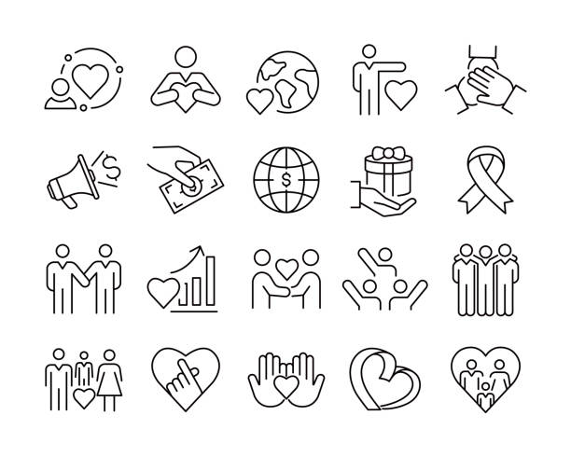
The role of community engagement in aiding recovery
“It’s a journey of being, belonging and becoming”

Slide 2
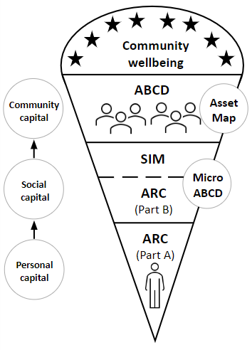
Underpinned by
Asset Based Community Development
CHIME
Recovery capital

Slide 3
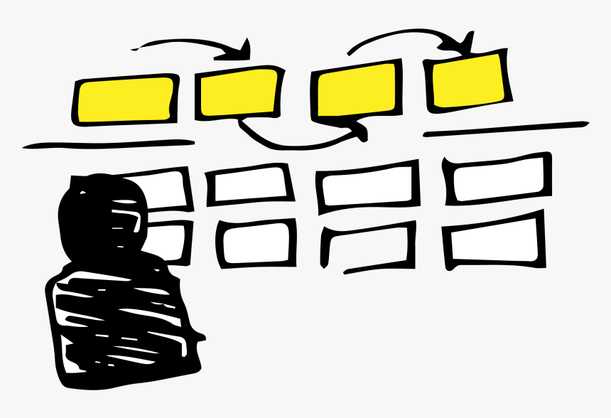
Asset Based Community Engagement framework
A systematic approach to mapping resources
Four domains (professional services; recreation, sports and arts; peers and mutual aid; education, employment and training)
Plus:
Barriers to community engagement
Desire to become engaged
Potential resources to engage with
Levels of active citizenship

Slide 4

A closer look at community engagement
What supports the accumulation of recovery capital?
Number of assets engaged with
Number of domains assets are listed under
What are the differences by gender?
Activity type
Desire to be more engaged
Barriers to engagement
Community engagement scale
Sport,
recreation
and arts
Education, employment and training
Professional services
Peers and mutual aid
Notes:
Men/ barriers – not knowing enough about the resource
Desire to be engaged – important and based on the individuals own circumstances (not appropriate to link everyone in with assets e.g. if already working and caring for a child too)

Slide 5
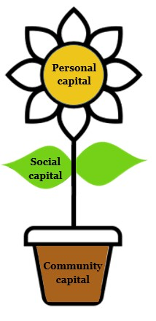
The relationship between community engagement and improvements in recovery
Sport,
recreation
and arts
Education, employment and training
Professional services
Peers and mutual aid
Notes:
Promising – for individuals to make substantial progress, there needs to be a shift away from professional services to those in the wider community BUT this is only appropriate if/ when prof support is no longer required

Slide 6


Theme 1:
Community
“[Service] have always been there, and they've had a massive impact but the changes that I've seen in the last 12 months have been down to the church. I think that [service] got me 90% of the way, but they've never got me that final 10%”
“It might change into something else, mightn’t it, the fact that I am not sat at home, I am out doing something. It’s a start”

Slide 7

Theme 2:
Social
“I’ve always been like, where do you meet new people? Oh, the pub. And now I’ve found out just by accessing one place you can find other places. It just opens it up and stops you from only meeting people in pubs which is handy”
“So anytime he [recovery worker] sees something that he thinks might be worth my while he mentions it to me”

Slide 8
Theme 3: Personal
"I mean I could sit there knitting, it's not about that, knitting is not something that I would actively go and look to do, it's about the people that are there and being part of something”
“The Recovery Games last week – climbing up a net. I says I couldn’t have done that a few months ago. I said I know you’ve got me on the end of a rope, but I’d have fell off five months ago. I wouldn’t have done that”

Slide 9
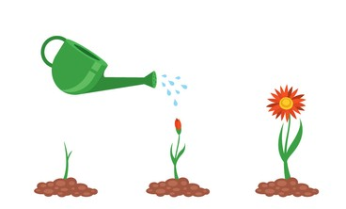
So what does this mean?
Professional services have a role to play in connecting individuals with wider activities
Those with lower levels of recovery capital and/ or community engagement must be prioritised
Gap in provision for supporting men (support/ barriers listed)
A shift away from ‘recovery focused’ activities to support longer term recovery growth
Ripple effect
Notes:
Shift away = particularly important for women. They were more likely to move outside of the ‘recovery sphere’ sooner, perhaps to counteract levels of stigma/ marginalisation previously faced. Women seems to form several identities (this is important for them), whereas men are more likely to remain in the recovery sphere for longer

Slide 10

Other implications
The importance of community connection must be recognised
Definitions of community capital specifically need to recognise the importance of wider community engagement (not just recovery focused groups)
Funding must be available to make this possible – meaningful activities

Slide 11
