Slide 1
BRAINS OR PERSONS? IS IT COHERENT TO ASCRIBE PSYCHOLOGICAL POWERS TO BRAINS?
NDSAG Conference 2022
Symposium for the book ‘Evaluating the Brain Disease Model of Addiction’
Thursday June 9 2022
Dr Tim Leighton

Slide 2
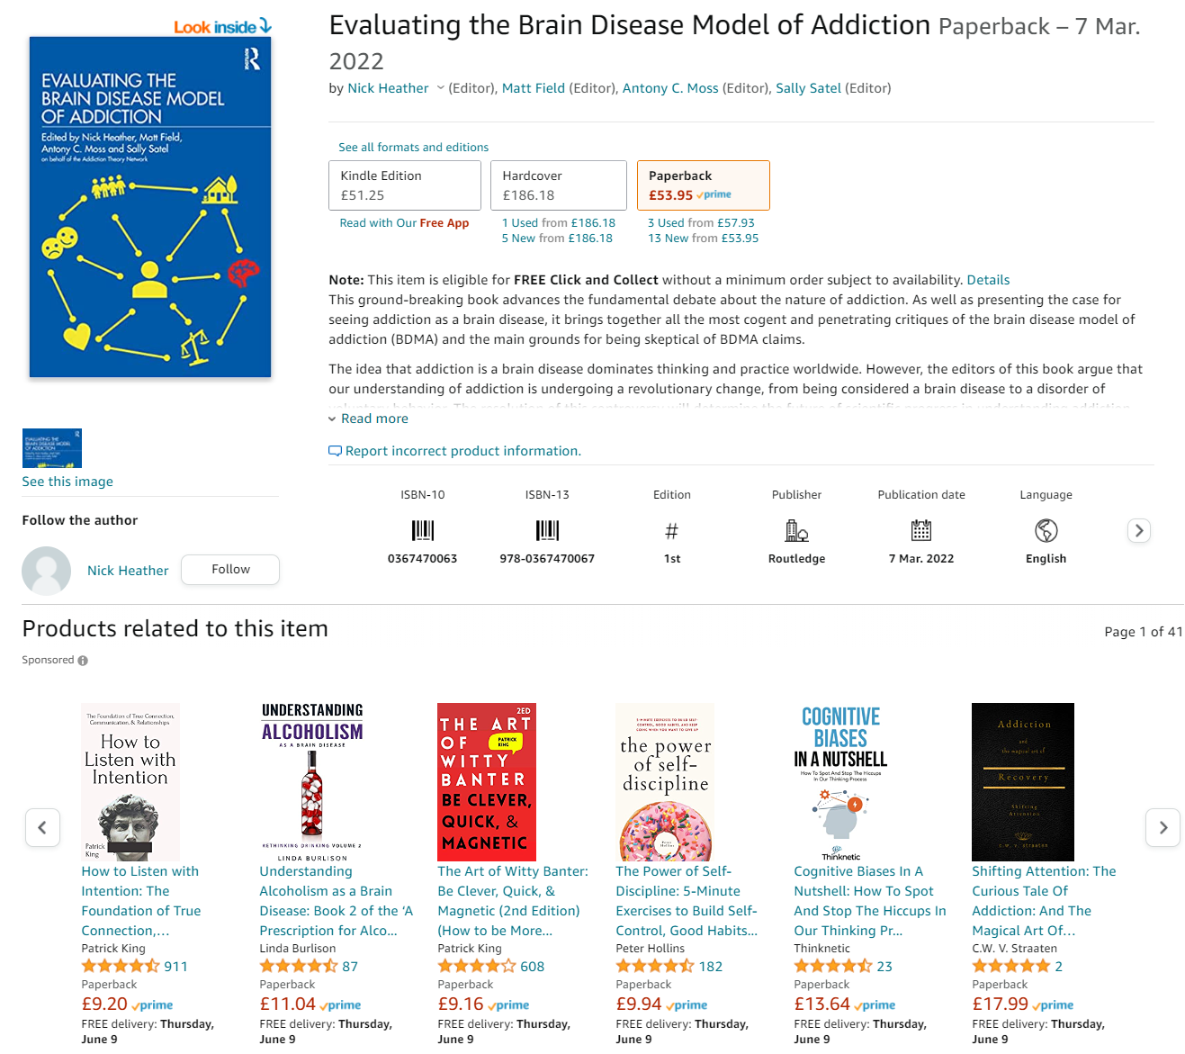

Slide 3
My position on the BDMA
I have reservations about the BDMA on various counts, most covered in other chapters in the book.
I am not, and the chapter is not, anti-neuroscience.
Neuroscience clearly has a valuable role to play in understanding brain mechanisms that may be implicated in compulsive/appetitive behaviour.
I am anti-reductionist when it comes to understanding human beings.
In my view there are serious philosophical problems with the BDMA regarding its coherence.
I believe the concept “brain disease” to be coherent and that certain things belong to that class.
I am not convinced what we call addiction belongs to that class.

Slide 4
Today’s talk
Highly selective – not easy to compress the arguments of this chapter into 15 minutes.
My chapter owes a great deal to the philosopher Peter Hacker, to the neuroscientist Maxwell Bennett, and to the philosopher/neuroscientist/medical doctor Raymond Tallis.
Also to John Greenwood and Mary Archer – I have become convinced that critical realism has the most to offer in helping us form coherent alternatives to the peculiar conclusions about addiction reached by both positivist and constructivist/interpretative accounts.
And perhaps most of all to the historian Nancy Campbell, one of the most enlightening authors in our field.

Slide 5
Reductionism
“All the explanatory arrows point downward, from societies to people, to organs, to cells, to biochemistry, to chemistry, and ultimately to physics. Societies are explained by people, people by organs, organs by cells, cells by biochemistry, biochemistry by chemistry, and chemistry by physics.”
S. Weinberg, physicist.
“Should we not look to science to understand ourselves? The answer is no, because natural science has flourished by marginalising something central to our humanity. It is essentially objective, quantitative and general . . . By contrast, our humanity is defined by subjective, qualitative, individual experience characterised by agency.”
R. Tallis, humanist.

Slide 6
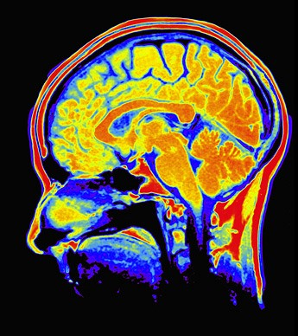





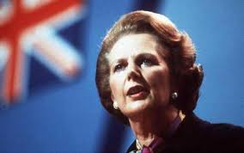
Agency and Structure
Related in various ways in Social Science (e.g. Giddens’ Structuration theory)
Conflation and Reduction abound! (e.g. ‘Brainism’, Rational Choice Theory, class reductionism of (some) Marxism)
We need to engage with “the complexity, openness, and ambiguity of social action.” and reject both upward and downward conflation.

Slide 7
Historical background
Radical relocation of addiction to the brain
A new concept of the ‘brain-based self” emerged in late 20th c. producing “a drastic relocation of the problematic aspects of addiction from the social to the neurobiological”
(Campbell, 2011, p.194).
Neuroscientific discourse began to suggest strongly that the brain itself had experiences, and that it had agency.
“Drugs, it seems, banish all other desires and fundamentally transform their users . . . The myth of pharmacological omnipotence is a culturally specific “truth” inscribed in U.S. drug policy” (Campbell, 2000, p.7).

Slide 8
Addiction only a meaningful concept in humans
No matter what analogies there may be or to what extent processes such as incentive-sensitization transfer to human research subjects, it is incoherent to revert the concept of addiction back to the world of animals.
Animals cannot have any concept of purposive drug use, of the sociality of drug use, or of the social disapproval of drug use, or subjective compulsion/craving, or the intention to resist a behavior, all of which are irreducible components of addiction.

Slide 9
The mereological fallacy
The ascription of attributes to a part which can only logically be ascribed to the whole.
Aristotle, Wittgenstein, Strawson, Hacker & Bennett.
Does the BDMA involve the mereological fallacy?
Many neuroscientific authors seem to recognize/acknowledge the issue.
However - when the pre-frontal cortex is given a ‘prominent role’ in ‘executive function’, including ‘inhibitory control, decision making, emotional regulation, purposefulness, motivation, and salience attribution’ (Volkow et al., 2012) human/personal capacities are clearly being reduced to brain activity.

Slide 10
The mereological fallacy
The attribution of psychological attributes to the brain (and individual parts of the brain) are typically used in neuroscientific literature “to explain the possession of psychological attributes and the exercise (and deficiencies in the exercise) of cognitive powers by human beings” (Bennett & Hacker, 2003, p.3).
This they argue is illegitimate and leads to conceptual confusion.
“What neuroscience cannot do is replace the wide range of ordinary psychological explanations of human activities in terms of reasons, intentions, purposes, goals, values, rules and conventions by neurological explanations. And it cannot explain how an animal perceives or thinks by reference to the brain’s, or some part of the brain’s, perceiving or thinking. For it makes no sense to ascribe such psychological attributes to anything less than the animal as a whole” ( p.3).

Slide 11
Where this leads to
The mereological fallacy is alive and well in popular scientific understandings of addiction:
“This gives us a picture of the thinking, feeling, living brain as it processes information!” (Steve Hyman)
“In short, your brain is you - everything you think and feel, and who you are” (NIDA, 2020)
“Addiction is in the brain and no amount of willpower can stop it!” (Aviary Recovery Center, 2020)
Conferences aimed at addictions practitioners – counsellors, therapists, doctors – often place enormous emphasis on claims that addiction is a brain disease.

Slide 12
Addiction as a cultural phenomenon
Drug consumption patterns, drug-related behaviors and subjective drug experiences vary in different cultures.
Prevalence, course, presentation of addiction also vary wildly
e.g. 9-times higher reported prevalence of AUD in USA compared with Netherlands
As do understandings of addiction
e.g. Hänninen and Koski‐Jännes (1999)
Loss of control is by no means a feature of most of these understandings
Notes:
Pawson & Tilley’s characterisation of social programmes essentially as “suggestions for future action” whose success depends on these suggestions “entering the reasoning of subjects” (Pawson & Tilley 1997, p51) can be applied to drug treatment and rehabilitation programmes and also to psychotherapeutic or counselling conversations generally, an idea that goes back 50 years to Jerome Frank’s classic ‘Persuasion & Healing’ (Frank 1961). Rather than a dose of technology, these programmes consist of human interactions involving persuasion. I am aiming at understanding how this process of persuasion works, and what contextual influences are occurring within the activity of the programme¹.

Slide 13
PEOPLE MAKE DECISIONS, NOT BRAINS
The predicament of addiction is crucially socially situated, not only inasmuch as social attitudes to addiction and addicted people vary but with that variation so too do the real-world course and consequences.
Despite the often considerable difficulty of stopping addictive behavior, to which the neural changes being identified by neuroscience surely contribute, people tend to exit from addiction when they become convinced that the negative consequences outweigh the value, and when they are able to maintain the value that addiction provided in alternative ways.

Slide 14
MISTAKING CAUSAL CONDITIONS FOR CAUSES
Brain states provide the indispensable causal conditions for human experience/ behaviour but are not necessarily to be identified as the cause of it.
Unlike genuine brain diseases such as Parkinson’s disease or Alzheimer’s, the addicted person’s ability to want things, to decide, choose actions and so forth is always to some degree independent of the brain changes that drug use has caused.
Genuine brain diseases cannot be overcome by making new behavioral and lifestyle choices.
The brain disease model also fails to comprehend how human desires, wants, appraisals, decisions are constitutionally embedded in a socio-cultural context.

