Slide 1
Discussion
Ed Day
Notes:
Brain disease model is philosophically wrong
Undermines public health continuum approaches
Use of a psychological model to deliver change that maps back on to BDMA
JBD argument – instead of problem-focused and scientistic explanations of addiction, we need to recognise that addictive behaviours are not a sole/primary consequence of people’s diseased brains or disordered decision-making. They occur for reasons and arise on social, historical, cultural, legal, economic, and environmental contexts that shape behaviours, how they are construed, and how they are responded to in important ways. Progress will be limited until we begain to pay as much attention to these reasons and influences as we have to individuals and their brains.

Slide 2

Background
‘…provide a leadership role to help improve the prospects of individuals seeking to recover from substance misuse, galvanising effective partnership working at national and local levels to secure effective recovery outcomes’
Encourage greater partnership working at a national and local level
Offer advice on how evidence-based practice can be most effectively applied
Notes:
With this in mind, surely the BDMA is a godsend… evidence-based and something we can all get behind, reducing stigma?

Slide 3
The BMDA as a unifying force…
Notes:
Not done a great job

Slide 4
ICD-11 Alcohol Dependence Endorsement of 2 of 3 core features in past 12 months
Impaired control over alcohol, including craving
2. Alcohol becomes increasingly prioritized in life, often despite problems
3. Physiological features caused by pharmacological tolerance and withdrawal
Early full remission:
Abstinence from alcohol lasting 1-12 months
Sustained partial remission:
Significant reduction in alcohol consumption for more than 12 months
+ Not meeting criteria for dependence
Sustained full remission:
Abstinence from alcohol lasting 12 months or longer
Notes:
Diagnostic muddle (perhaps

Slide 5
DSM-5
Physiological correlates of alcohol use
Tolerance
Symptoms of withdrawal
Loss of control over alcohol use
Drinking longer/larger amounts than intended
Unsuccessful attempts to cut down/control use
Alcohol taking over other meaningful activities
Time spent in activities related to alcohol
Other activities given up because of alcohol
Problems resulting from alcohol use
Craving
Failure to fulfil role obligations
Social or interpersonal problems
Physical or psychological problems
Use in situations that are physically hazardous

Slide 6
MHA 1983 (2007 update)
The use of alcohol or drugs is not, by itself, regarded clinically as a disorder or disability of the mind (although the effects of such use may be). However, dependence on alcohol and drugs is regarded as a mental disorder.
The effect of the exclusion inserted by this section is that no action can be taken under the 1983 Act in relation to people simply because they are dependent on alcohol or drugs (including opiates, psycho-stimulants or some solvents), even though in other contexts their dependence would be considered clinically to be a mental disorder.
Like treatment for any other condition which is not itself a mental disorder, treatment for dependence may be given under the 1983 Act if it forms part of treatment for a condition which is a mental disorder for the purposes of the 1983 Act (see section 7 below for the definition of medical treatment).
Notes:
It does not mean that such people are excluded entirely from the scope of the 1983 Act. A person who is dependent on alcohol or drugs may also suffer from another disorder which warrants action under the 1983 Act (including a disorder which arises out of their dependence or use of alcohol and drugs or which is related to it). Nor does it mean that people may never be treated without consent under the 1983 Act for alcohol or drug dependence.

Slide 7
MHA 1983 (2007 update)
The use of alcohol or drugs is not, by itself, regarded clinically as a disorder or disability of the mind (although the effects of such use may be). However, dependence on alcohol and drugs is regarded as a mental disorder.
The effect of the exclusion inserted by this section is that no action can be taken under the 1983 Act in relation to people simply because they are dependent on alcohol or drugs (including opiates, psycho-stimulants or some solvents), even though in other contexts their dependence would be considered clinically to be a mental disorder.
Like treatment for any other condition which is not itself a mental disorder, treatment for dependence may be given under the 1983 Act if it forms part of treatment for a condition which is a mental disorder for the purposes of the 1983 Act (see section 7 below for the definition of medical treatment).
Notes:
It does not mean that such people are excluded entirely from the scope of the 1983 Act. A person who is dependent on alcohol or drugs may also suffer from another disorder which warrants action under the 1983 Act (including a disorder which arises out of their dependence or use of alcohol and drugs or which is related to it). Nor does it mean that people may never be treated without consent under the 1983 Act for alcohol or drug dependence.

Slide 8
The BDMA guiding evidence-based practice…

Slide 9
26. ADDICTION TREATMENT PROVIDERS’ ENGAGEMENT WITH THE BDMA
Anthony Barnett, Michael Savic, Martyn Pickersgill et al.
Treatment in clinical practice is rarely viewed exclusively through the lens of neurobiology or a brain disease
Treatment providers engage in a process of ‘selective neurologization’ i.e. strategic and selective deployment of neuroscientific representations to foster client optimism or reduce self blame, enact drug use as a high-risk practice or explain complex polypharmacology
Example – explanation of Opioid Agonist Treatment or acamprosate

Slide 10
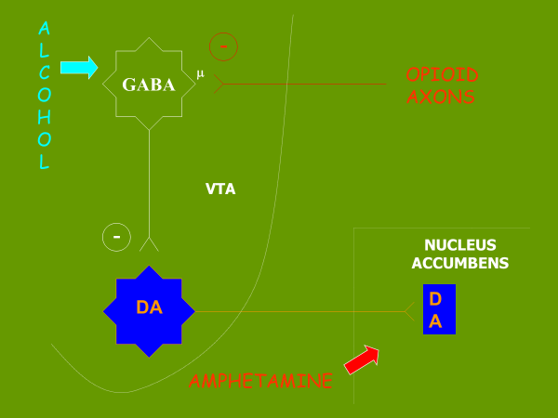
2003

Slide 11
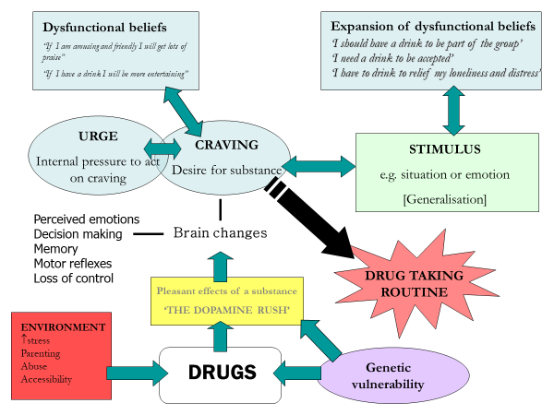
2006

Slide 12
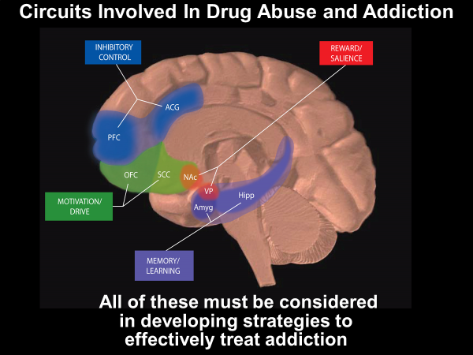
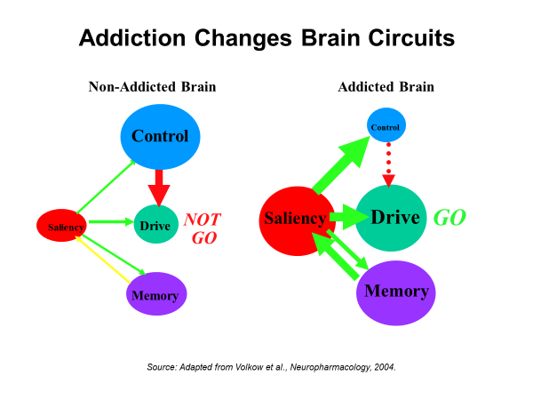
2009

Slide 13
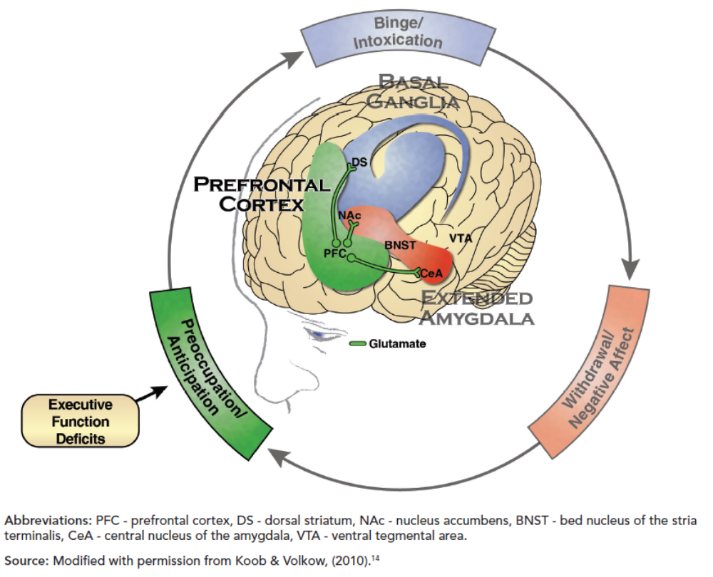
2019

Slide 14
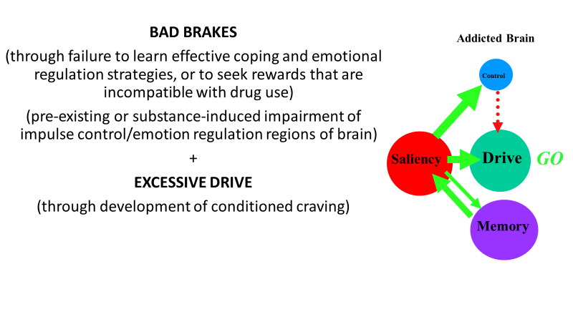

Slide 15
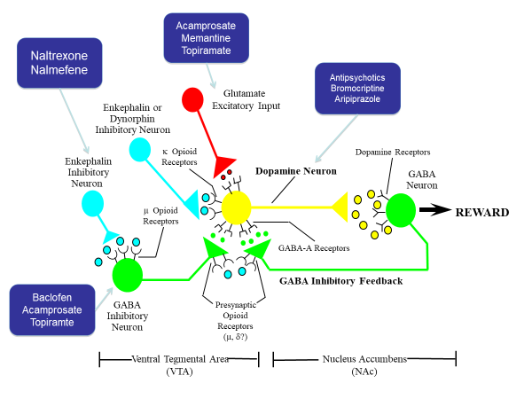

Slide 16
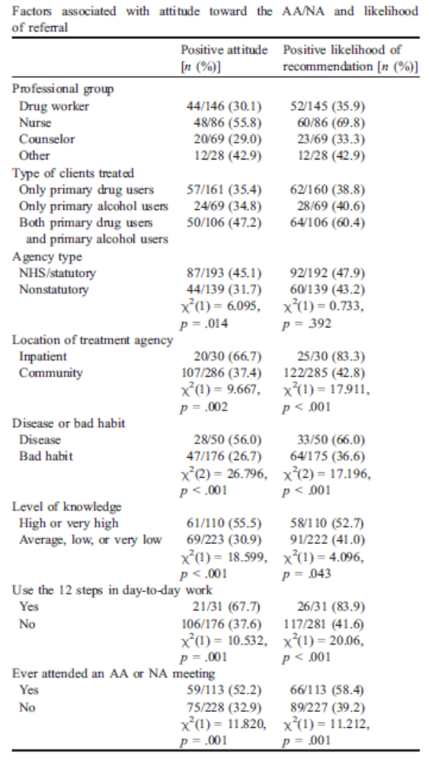
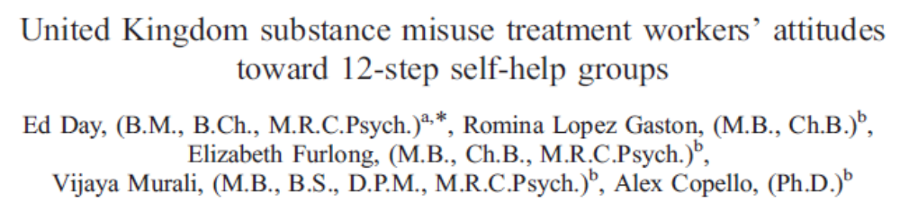
Disease = 22%
Bad habit = 78%
Notes:
Precious little evidence that the interventions people use are guided by these beliefs

Slide 17
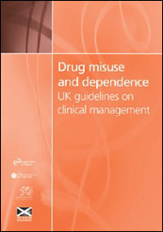
Clinical Guidelines
Dominated by biological/medical interventions
Next to nothing on non-medical interventions:
  1999 – 2-3 pages [132 pages in total] 2.2%
  2007 – 7-8 pages [128 pages] 6.3%
  2017 – 37 pages [317] 11.6%
Notes:
EBP has gone hand-in-hand with medical practice

Slide 18
Implications for Treatment Systems
One way to address providers’ multiple ontologies of addiction is to standardize care by implementing an overarching, universal addiction treatment model
  Use standard intake and assessment systems
  Standardise interventions and map client treatment pathways
  Ensure approaches are harmonized across the sector e.g. harm reduction
BUT this has unforeseen consequences:
  Creating a standardized treatment model is challenging
  A one-size-fits-all approach does not account for people’s complex needs
  An overarching model paternalistically relies on ‘expert’ knowledge at the expense of client-centred care

Slide 19
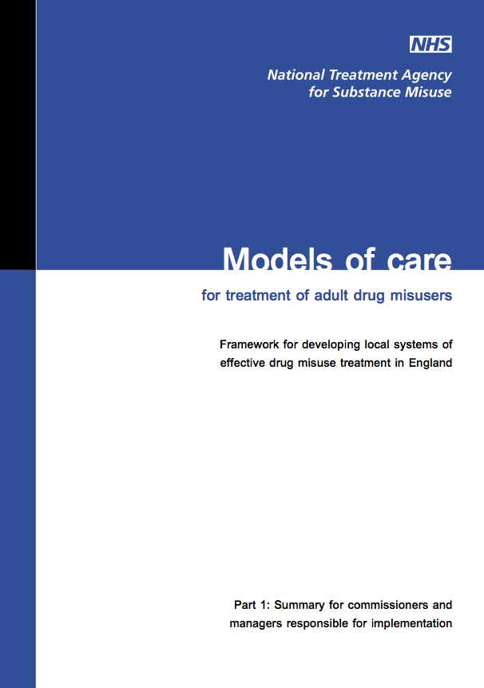
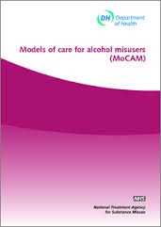

Slide 20

2000s
Expansion of services
Application of evidence-based prescribing
Criminal Justice diversion
Health & Social Care Act
2010s
Any qualified provider
Recovery and ROIS
More emphasis on peer support
Shrinking financial envelope
Financial crash & Austerity
Notes:
Other factors play a crucial role in how this is interpreted… not least money and politics

Slide 21
Control over substance use, optimised health and well-being, and participation in the rights, roles and responsibilities of society
Use of any substance in a manner, situation, amount or frequency that can cause harm to the user and/or to those around them
Clinically and functionally significant impairment caused by substance use, including health problems, disability, and failure to meet responsibilities at work, school or home
ENHANCING HEALTH
PRIMARY PREVENTION
EARLY INTERVENTION
TREATMENT
RECOVERY SUPPORT
Substance use status continuum
Substance use care continuum
Notes:
So where does this leave us
In reality, I teach the BDMA, but I preach everything that our speakers have told us today
Full spectrum…

Slide 22
UK Drug Policy Commission: www.ukdpc.org.uk
A process that takes time to achieve and effort to maintain
Voluntarily-sustained
Accrual of positive benefits
Requires aspirations and hope
RECOVERY
No one path to recovery
Requires control over substance use (although it is not sufficient on its own)
A satisfying and meaningful life, as defined by the person themselves, involving participation in the rights, roles and responsibilities of society
Maximises health and well-being, encompassing both physical & mental good health
Notes:
But recovery in the most severe cases

Slide 23
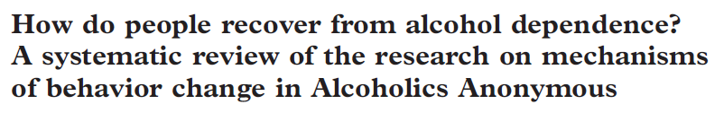


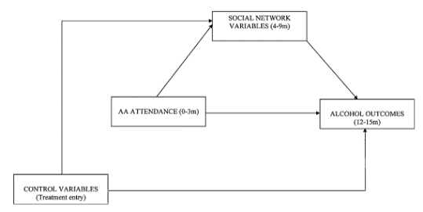
COMMON PROCESSES
Self-efficacy
Active coping efforts
AA-SPECIFIC PRACTICES
AA Behaviours/activities
AA Beliefs/cognitions
SOCIAL & SPIRITUAL PROCESSES
Social network variables
Spirituality variables
Commitment to abstinence
RESULTS:
AA helps people to recover through
1. common process mechanisms [⬆ self-efficacy, coping skills & motivation]
2. facilitating social network changes
Notes:
Lots of techniques work, and it turns out that there are lots of common processes
BUT it doesn’t do any harm to understand these processes and focus in on the effective parts

Slide 24
“We must move away from construing addiction in terms of (near) inescapable compulsion, acknowledge the importance of wider influences on ‘addictive’ behaviours, and help empower individuals to exercise volitional control”
Heim & Monk (Chapter 14 ‘Recovery is Possible’)

Slide 25
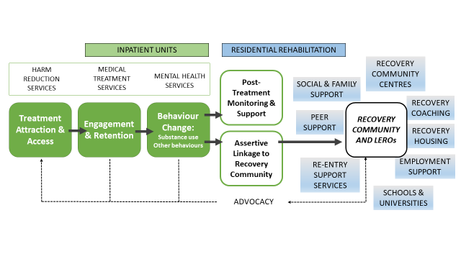
NATURAL RECOVERY
MUTUAL AID GROUPS
ADDICTION
RECOVERY
RECOVERY ORIENTATED SYSTEM OF CARE (ROSC)
ACUTE CARE + MEDICAL STABILIZATION + LONG-TERM RECOVERY MANAGEMENT + RECOVERY SUPPORT SERVICES
Notes:
Overall – as RC I promote the ROSC
I believe the quote ‘We must move away from construing addiction in terms of (near) inescapable compulsion, acknowledge the importance of wider influences on ‘addictive’ behaviours, and help empower individuals to exercise volitional control’

Slide 26
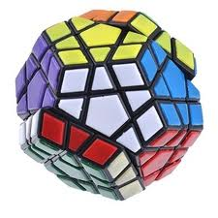


Notes:
What the book does is elucidate in beautiful detail what we already know – that this is complicated
However people want simple black or white solutions…
we need to recognise that addictive behaviours are not a sole/primary consequence of people’s diseased brains or disordered decision-making, but occur for reasons and arise on social, historical, cultural, legal, economic, and environmental contexts that shape behaviours, how they are construed, and how they are responded to in important ways. Progress will be limited until we begain to pay as much attention to these reasons and influences as we have to individuals and their brains.

