Slide 1
Psychotherapeutic strategies to enhance motivation and cognitive control
New Directions in the Study of Alcohol
London South Bank University
Dr Frank Ryan, Visiting Research Fellow, London South Bank University.
9th June 2022
ryanf@lsbu.ac.uk

Slide 2
Overview of presentation
Promote a focus on cognition, motivation – especially reward processing- in a biopsychosocial context.
Describe a therapeutic framework that focuses on these core processes
Provide three examples of cognitive strategies that offer to enhance self-regulation in the realm of addiction :
“Now vs Later” technique.
Episodic Future Thinking.
Implementations intentions.
Conclusions and questions (time permitting!)

Slide 3
A motivational problem with a cognitive solution.
Overcoming and managing addiction entails appreciating and re-directing motivation, not suppressing it: this acknowledges the “neural coercion” that subserves addiction.
Cognitive and behavioural change tactics offer the most promising approach to overriding the coercive or compulsive components of addiction.
These cognitive –behavioural interventions are likely to be more effective when rehearsed and practiced, as addictive reward seeking is reflective / deliberate but enaction or consummation is reflexive/impulsive.
Core cognitive control processes are recovery congruent goal selection, goal maintenance and sustained attention (essentially working memory or executive attention).

Slide 4
A biopsychosocial framework
Cognitive
Control
Cognitive control is amenable to therapeutic efforts e.g. goal installation in working memory; metacognitive strategies to govern attention.
Neurodevelopmental factors/ exposure to adversity or trauma.
Neurobiological Factors: genetic, epigenetic, reward sensitivity.
Sociocultural or environmental factors
Notes:
A given individuals’ pathway to addiction is shaped by the interaction of many factors over time and in a developmental timescale. Cognitive control is placed at the top of the hierarchy as this is the most immediately accessible workspace to leverage patterns of addictive behavior.
4

Slide 5
Predicting reward
Dopamine release acts as a learning signal: it predicts something that is “good for me”.
This is essential for survival which entails the relentless pursuit of rewards linked to satiation.
Drugs with abuse or addictive liability short-circuit or hijack this powerful innate neural reward processing system.
Non-delivery of expected rewards leads to suppressed dopaminergic functioning and anhedonia.

Slide 6
Reward learning is therefore key
Positive Reward Prediction error attributes salience
Stimuli capture attention.
Stimuli encoded in working memory (WM)
Addictive goal in WM triggers action tendency

Slide 7
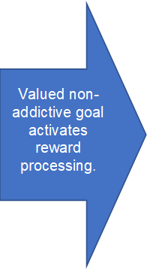
Identifying new – and more distant- rewards is core therapeutic process.
Novel stimuli gradually acquire salience
Stimuli gain access to working memory
Recovery or restraint goal activates action tendencies

Slide 8
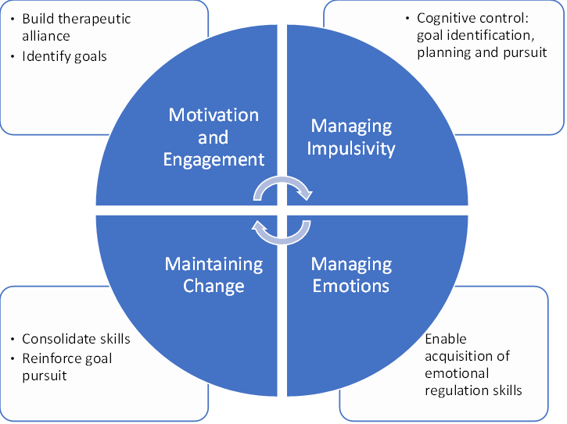

Slide 9
4 Ms
Motivation and engagement
Manage impulsivity
Manage Negative emotions
Maintain Change (relapse prevention)

Slide 10
Motivation defined
Motivation is a covert process (initially!) that mediates a person’s response to a stimulus:
Reflected in goal directed behaviour that either a) entails pursuit and engagement / enjoyment of desired goals or b)
Avoidance or rejection of aversive or unwanted stimuli or situations. (see Numan, 2015, p4)
Notes:
Working memory or cognitive processing variation would be a modulator. Here I see status of person i.e. abstinent / not as a mediator between S-R A volitional model!

Slide 11
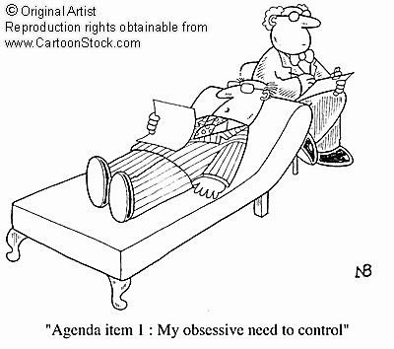
What is cognitive control?
Shifting attention (engagement and disengagement)
Monitoring and updating (short term memory merging into working memory)
Inhibition of prepotent/impulsive responses
Note these processes are competing for scarce resources or “bandwidth”.
(Miyake et al 2000)
Notes:
Self-regulation entails longer term strategic goals and planning.
11

Slide 12
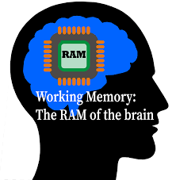
Working memory
A flexible time limited, capacity limited mental workspace that ensures focus on goals and goal pursuit. Sustained attentional focus requires inhibitory function which is a significant drain on the brains “battery”.

Slide 13
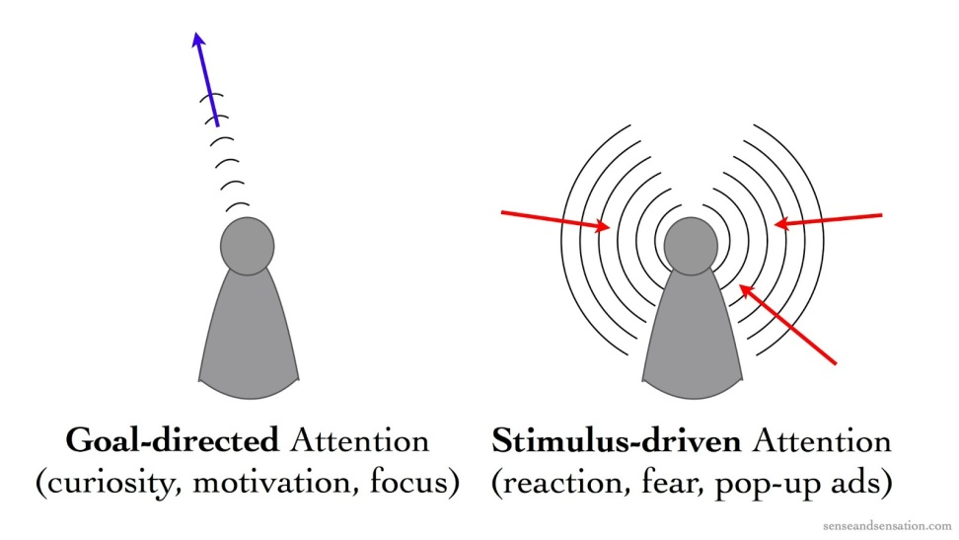
Attentional Control Theory see Eysenck, M. W., & Derakshan, N. (2011).
Anxiety (and by analogy craving or urgency) impairs efficiency rather than effectiveness. The task is accomplished but with more effort.
When anxiety levels are high, goal directed attention is impaired and stimulus driven attention potentiated.
Implication is more mental effort (willpower) is needed. But this runs out.

Slide 14
Dual processing: drug use becomes automated, but controlled conscious processes still operate.
Cognitive appraisal
Level of processing
Controlled processing
(slow)
Activation of addiction related beliefs. e.g "I will have more fun if I use cocaine"
Cue detected
Automatic processing
(fast)
Conditioned cue reactivity : somatovisceral arousal and approach tendency
Notes:
From Cognitive Therapy for Addiction (Ryan 2013)
14

Slide 15
1. Now vs later technique
 |  | NOW (Immediate Consequences) | LATER (Delayed Consequences)
Positive Outcomes Example | Excitement of anticipated win; stopped feeling stressed about work. |  | I’ve learned that it is difficult to control my impulse to gamble. I will be able to see the warning signs earlier if this happens again.
Negative Outcomes Example |  | I have no spare cash, just using my overdraft. I’ve left myself down | I’ve lost more money and I had to borrow until the end of the month.
 |  | Now | Later
My Positive outcomes
My Negative Outcomes

Slide 16

Neural substrates of “now” and “later” technique
Executive control circuitry is activated when restrained smokers think “later” rather than “now” (e.g. Dorsolateral prefrontal cortex (DLPFC) and cortico-striatal pathways)
Reduced activity in amygdala, ventral striatum and anterior cingulate
Craving is reduced by about a third
Kober et al, 2010.
f.ryan@imperial.ac.uk

Slide 17
2. Episodic future thinking
EFT (Atance & O'Neill. 2001) uses episodic memory to construct a virtual guide in advance. Peters & Buchel (2010) found evoking positive images of these future episodes reduced impulsivity on a delayed reward discounting task.
Creating and maintaining a cognitive representation of a valued future scenario will act to modulate the incentive value of anticipated addictive cues and make alternative reward signals more salient.

Slide 18

3. Implementing intentions to change
If situation X occurs I will perform behaviour Y e.g.
“If I have money I will do my shopping before visiting the cocaine dealer”
If I am offered alcohol to drink at the party I will say “no thanks, but I would love a mineral water”.
Prestwich et al (2006)
Notes:
18
IIs are more specific “If-then” statements rather than more general goal intentions such as “I will not drink”. Mention “Giro Junkie”. Also, ironic effects of simply suppressing urges “don’t think about drink” can be counterproductive

Slide 19
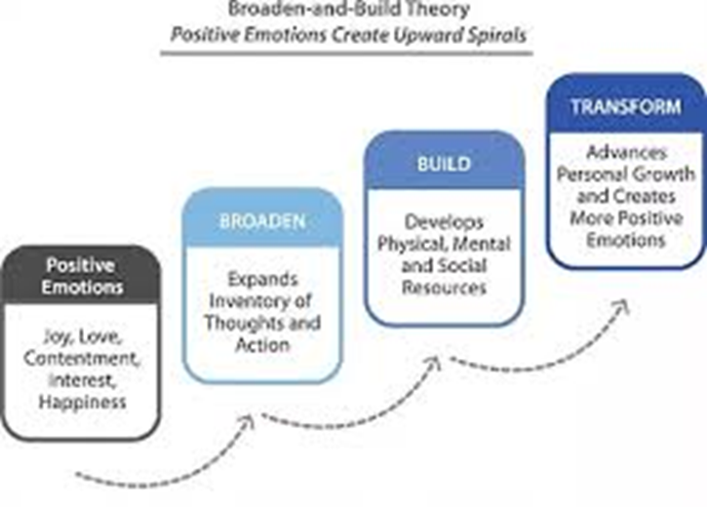
Broaden and build
Barbara Friedrickson
Negative emotions narrow attention and promote avoidance
positive emotions (joy, contentment, feeling sense of achievement) broaden attention and promote exploration and approach

Slide 20
Summary of Change Model
Enhancing cognitive control should be the primary target of therapy.
Seeking and finding alternative rewards is key to sustaining change.
Impulse control and emotional control strategies should be addressed sequentially, but as part of a formulated treatment plan in a framework that accentuates cognitive control.
Particular attention must be given to enhancing the therapeutic alliance: continuous feedback is used to motivate the client to remain engaged in treatment despite the inherent “treatment resistant” nature of addiction.
Addiction, once established, is an enduring condition because of the powerful learning mechanisms it subverts. Help seekers and their carers need to remain mindful of this in the years following treatment.
Overcoming automatic urges and craving can be exhausting; acceptance, metacognitive strategies & mindfulness can complement coping skills.

Slide 21

The brain is involved in all motivational, cognitive and behavioural operations. Addiction can sculpt the involved systems and circuits at every level in a profound and enduring, but often reversible, way.

Slide 22

Poetry, cognition and motivation
Two principles of human nature reign;
Self-love, to urge, and reason to restrain;
Nor this a good, nor this a bad we call,
Each works its end, to move or govern all.
Alexander Pope
An Essay on Man 1732

Slide 23


Background and Sources: Self-regulation

Slide 24

E-book/ journal (2016)
https://www.frontiersin.org/research-topics/3544/reward-processing-in-motivational-and-affective-disorders

