Slide 1
Any benefit to adding a brief online intervention for unhealthy alcohol use to websites targeting people with a different addiction or mental health concern?
John Cunningham
Nat and Loretta Rothschild Chair
in Addictions Treatment and Recovery Studies
King’s College London

Slide 2
Disclosures
Funding sources:
  Canada Research Chair in Addictions
  Canadian Institutes of Health Research
  National Institute on Alcohol Abuse and Alcoholism
  Manitoba Gambling Research Program

Slide 3
Why is it important to provide alternate ways to access help?
Only about 1 in 3 people with alcohol abuse or dependence ever seek help
Waiting lists, treatment dropout
Accessing help outside of office hours
Not all people who drink in an unhealthy fashion are alcohol dependent
Many people who drink in an unhealthy fashion are interested in self-help materials

Slide 4
Example brief intervention
https://screen.evolutionhealth.care/cyd
  18 Item Survey Contains:
    AUDIT
    Drinking on each day of a typical week
    Greatest amount on a single occasion
    Experience of psychosocial consequences
    Demographics
Normative comparison data for Canada, U.K., and USA

Slide 5
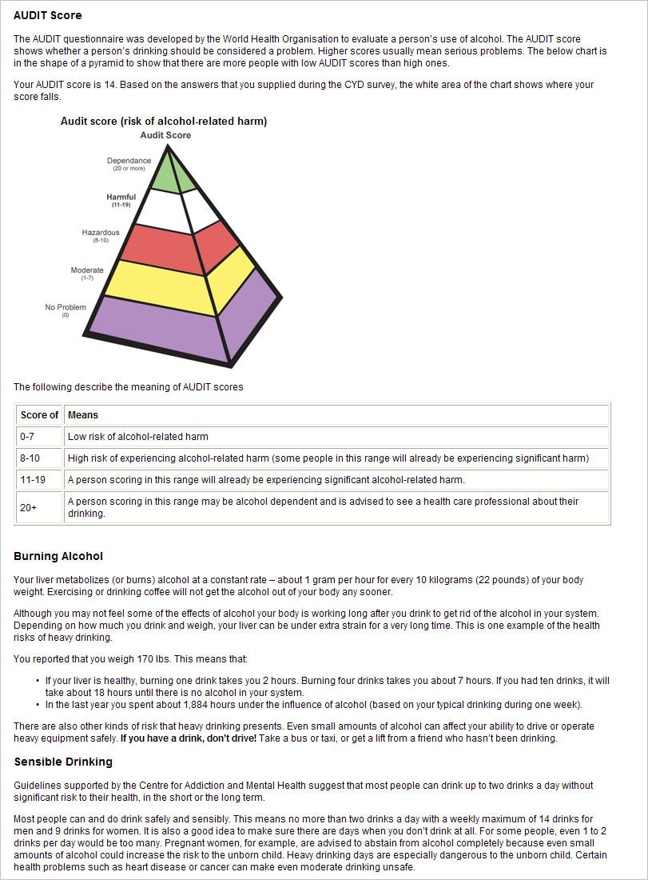
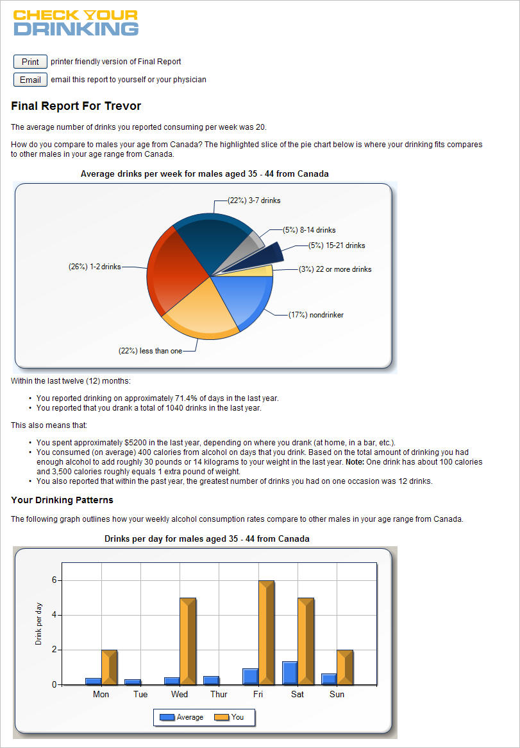
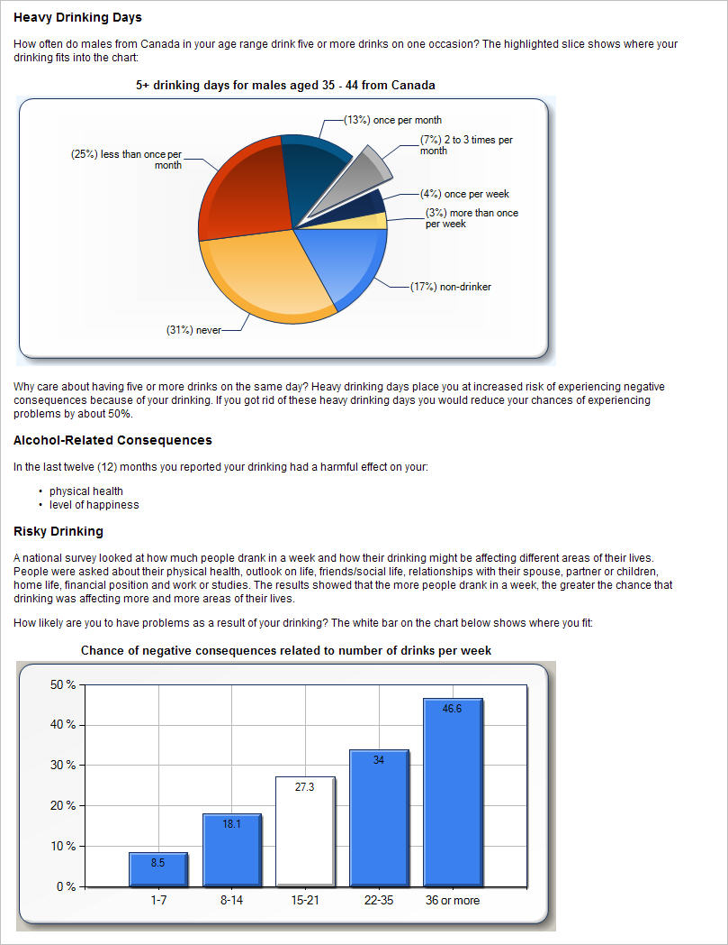

Slide 6
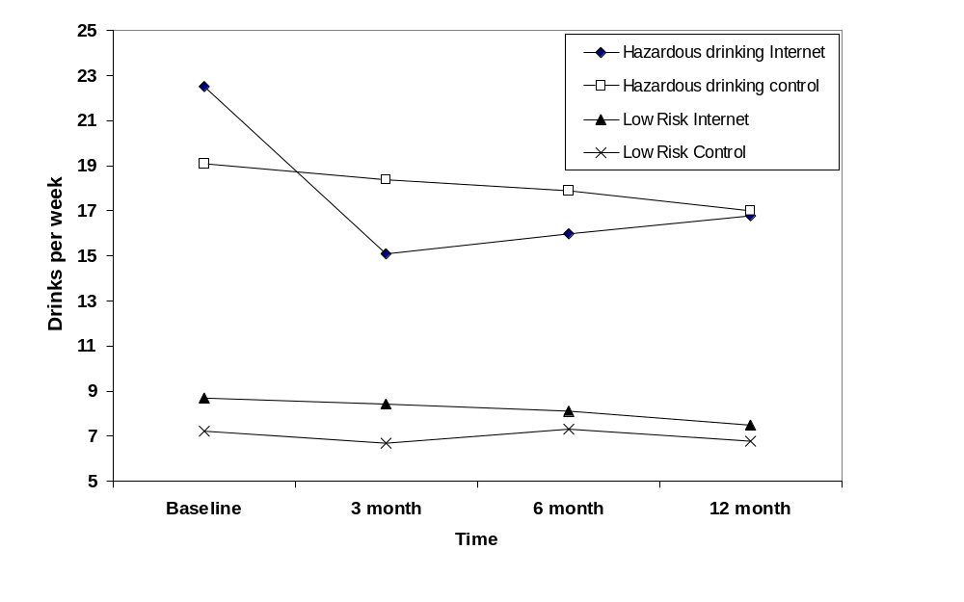
Impact of brief intervention

Slide 7
Depression and Alcohol Use
Depression and unhealthy alcohol use can be functionally interrelated
Many people with either concern are unable or unwilling to access face-to-face treatment
People with co-occurring depression and unhealthy alcohol use might seek help earlier for their depression than their alcohol consumption (Kay-Lambkin, 2014)

Slide 8
Previous Research
Schouten, M. J. E., Christ, C., Dekker, J. J. M., Riper, H., Goudriaan, A. E., & Blankers, M. (2021). Digital Interventions for People With Co-Occurring Depression and Problematic Alcohol Use: A Systematic Review and Meta-Analysis. Alcohol and Alcoholism.
6 studies
  3 in clinical settings
  1 in university students
  2 responding to advertisements
Overall, significant impact on drinking

Slide 9
Methods
Participants who were concerned about their depression were recruited using online advertisements
Identified those who met criteria for current depression and unhealthy alcohol use
Randomized to one of two conditions
  online intervention for depression (MoodGym-only)
  online intervention for depression plus one for unhealthy alcohol use (MoodGYM + CYD)
Participants were followed up at 3- and 6-months

Slide 10
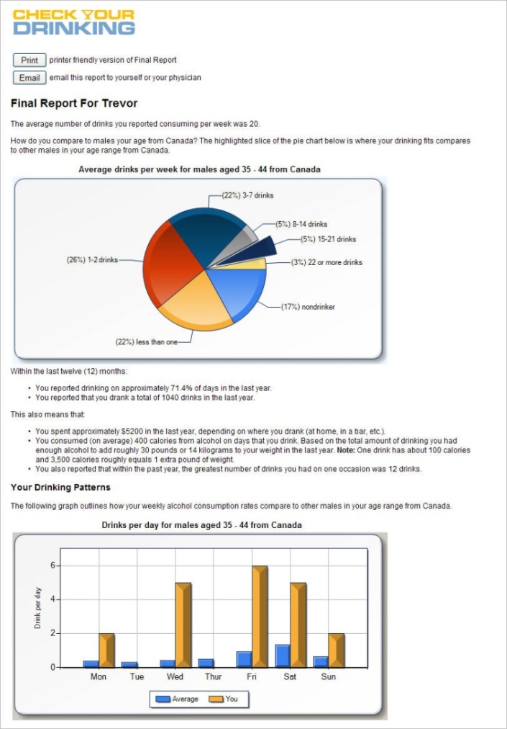
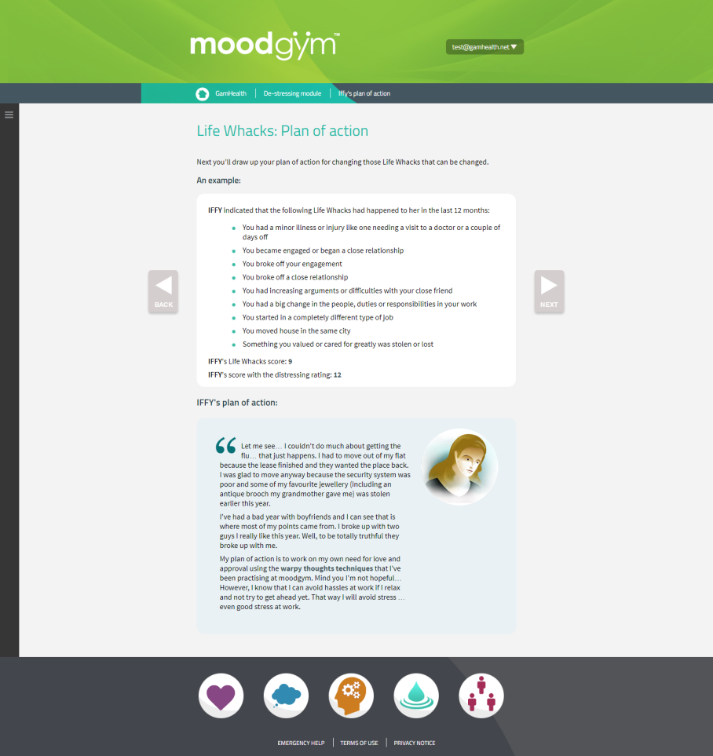
RCT of online interventions for co-occurring depression and unhealthy alcohol use

Slide 11
Among people seeking help for depression who also have unhealthy alcohol use

Slide 12
Negative impact?
No significant impact on Mental Health outcomes (CES-D scores – reduction over time but no difference between groups)
No significant impact on number of MoodGYM modules completed ( 2 of 5).
M + A participants logged into intervention homepage less often than M only (4.1 versus 4.9 times, p < .014)

Slide 13
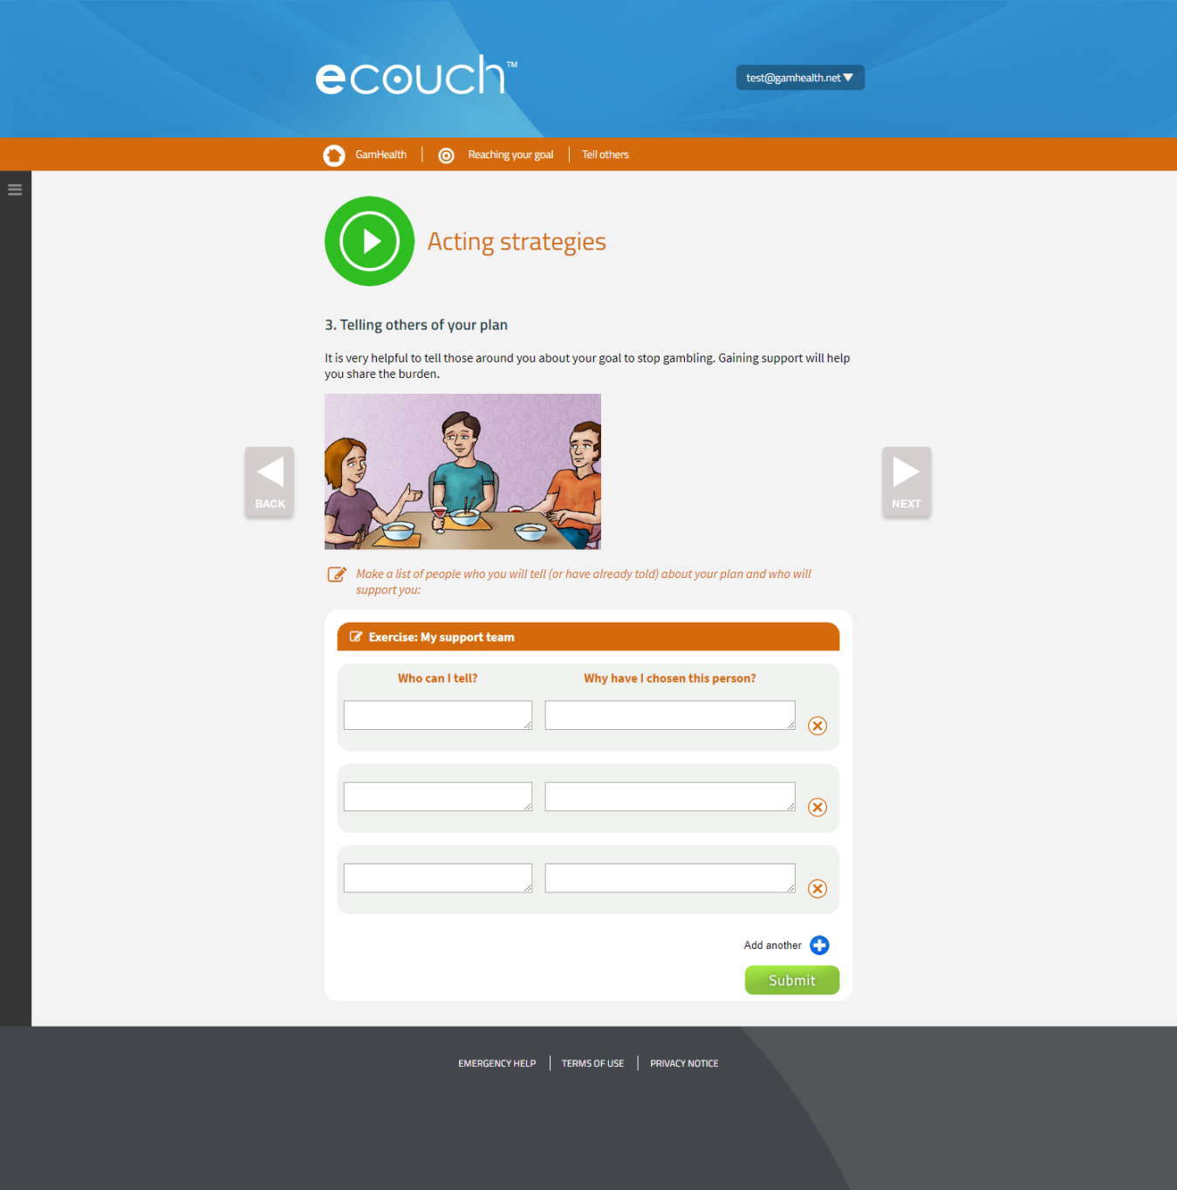
RCT of online interventions for co-occurring gambling and unhealthy alcohol use

Slide 14
Among people seeking help for gambling concerns who also have unhealthy alcohol use

Slide 15
Possible explanations
Recruitment method
Drinking intervention does not work in participants with co-occurring concerns
Drinking intervention is no longer effective

Slide 16
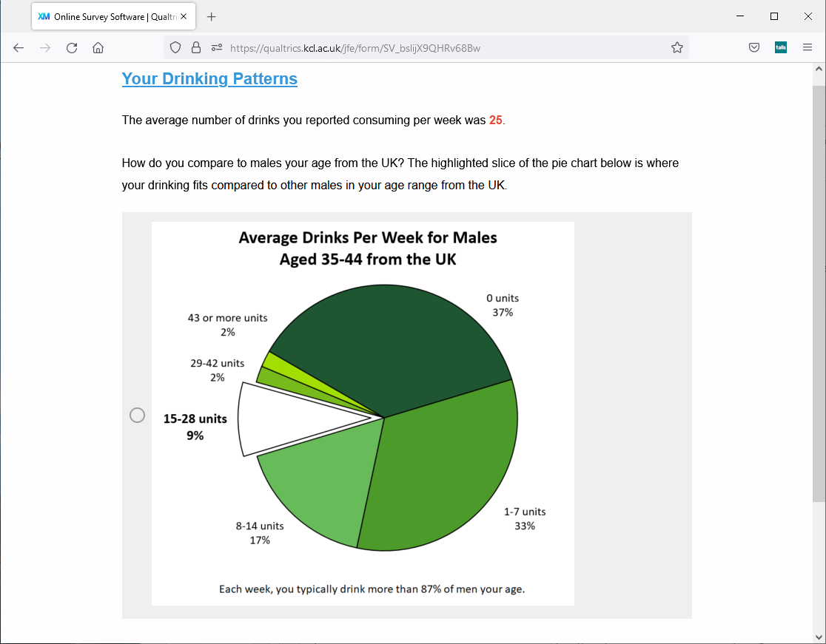

Slide 17
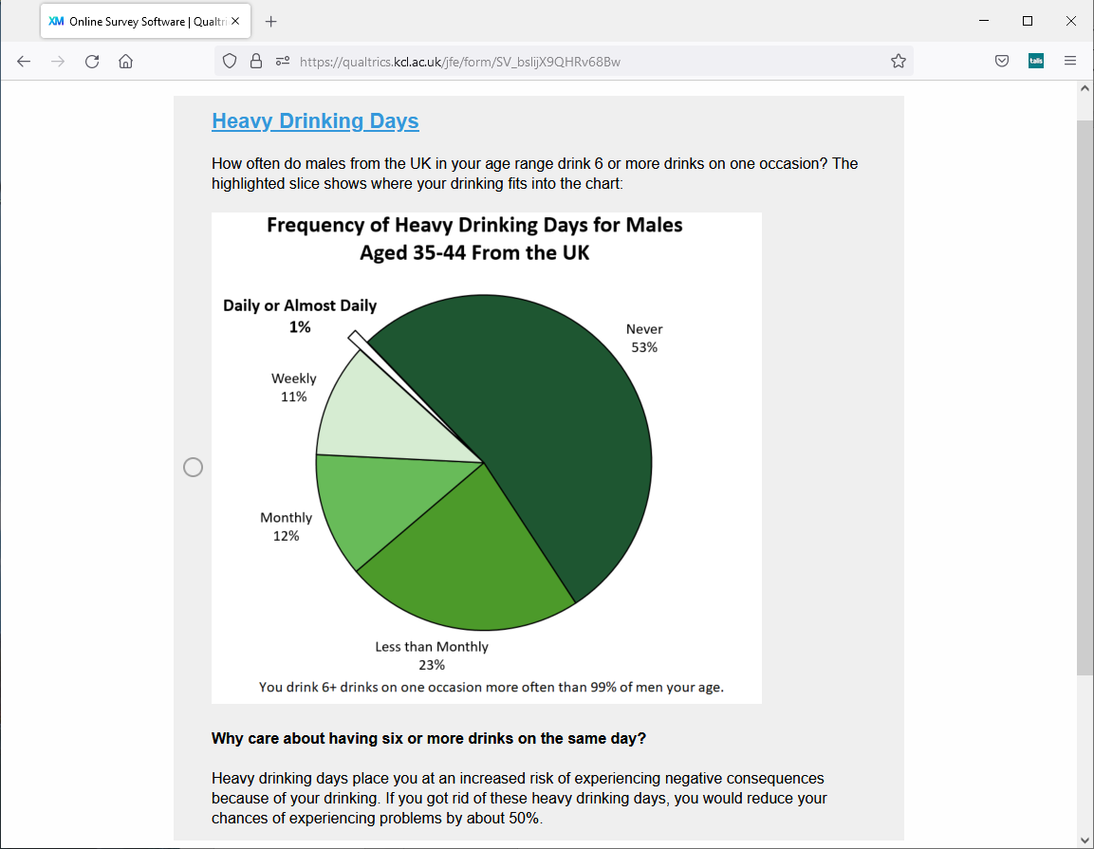

Slide 18
Future directions?
What happens when people accessing help for their drinking are offered additional help for another mental health or addictions concern?

Slide 19
Thoughts?
Cunningham, J. A., Godinho, A., Hendershot, C. S., Kay-Lambkin, F., Neighbors, C., Griffiths, K. M., & Schell, C. (2021). Randomized controlled trial of online interventions for co-occurring depression and hazardous alcohol consumption: Primary outcome results. Internet Interventions, 26, 100477.
Cunningham, J. A., Hodgins, D. C., Keough, M., Hendershot, C. S., Schell, C., & Godinho, A. (2020). Online interventions for problem gamblers with and without co-occurring unhealthy alcohol use: Randomized controlled trial. Internet Interventions, 19, 100307.
john.cunningham@kcl.ac.uk

