Slide 1
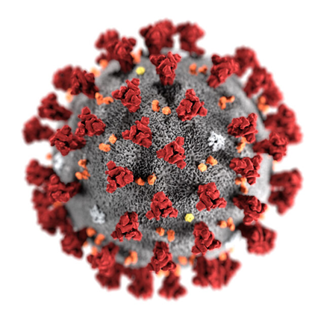
Alcohol and COVID-19: as the dust settles?
Department of Behavioural Sciences and Health
Dr Melissa Oldham

Slide 2
There were immediate changes in patterns of alcohol consumption in the UK during the first lockdown…

Slide 3
Polarised trends in UK lockdown drinking
48% drinking the same
26% drinking
less
26% drinking
more
Source: Garnett C, Jackson S, Oldham M, Brown J, Steptoe A, Fancourt D. Factors associated with drinking behaviour during COVID-19 social distancing and lockdown among adults in the UK. Drug Alcohol Depend. 2021:219;108461.

Slide 4
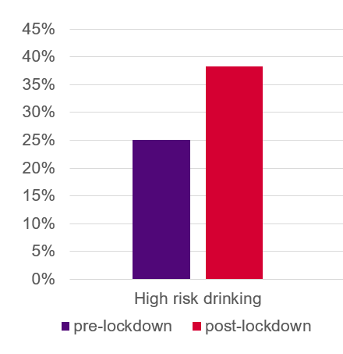
Increases in high-risk drinking…
Increase in high‐risk drinking in first lockdown
Defined as AUDIT-c score ≤ 5
25% pre lockdown vs 38% post lockdown
Source: Jackson, S. E., Garnett, C., Shahab, L., Oldham, M., and Brown, J. (2021) Association of the COVID‐19 lockdown with smoking, drinking and attempts to quit in England: an analysis of 2019–20 data. Addiction, 116: 1233– 1244.
Notes:
scoring ≥ 5 as high‐risk drinkers

Slide 5
..and Heavy Episodic Drinking
%
Source: Oldham, M., Garnett, C., Brown, J., Kale, D., Shahab, L. and Herbec, A. (2021), Characterising the patterns of and factors associated with increased alcohol consumption since COVID‐19 in a UK sample. Drug Alcohol Rev.. https://doi.org/10.1111/dar.13256
Notes:
Next we will look at changes in drinking patterns

Slide 6
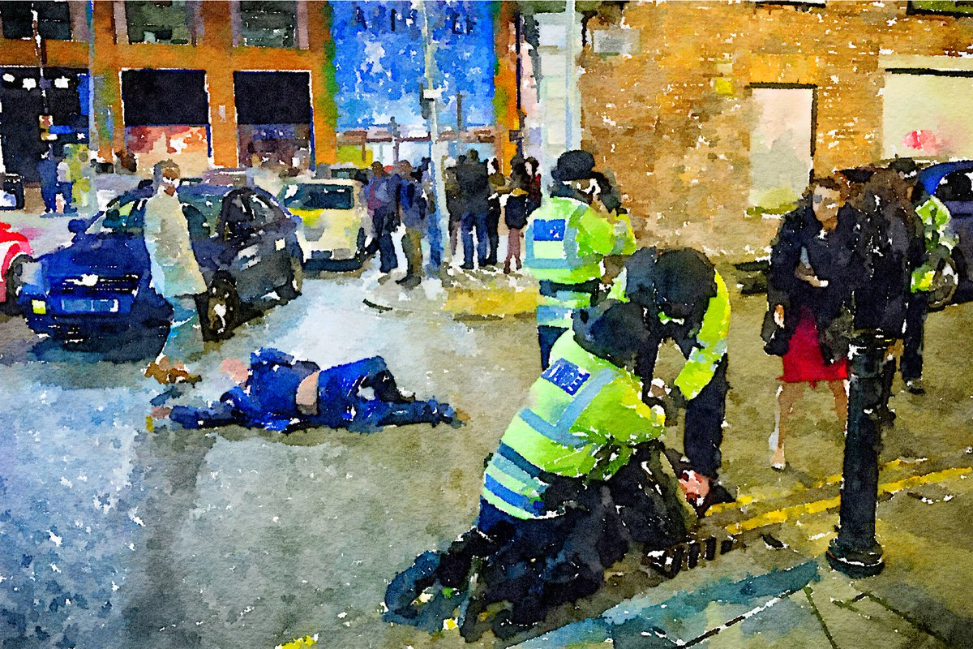
This matters due to different harm profiles
Dose-response relationship between alcohol and harms
More alcohol = more likelihood of experiencing harms
HED is linked to increased likelihood of short-term harms

Slide 7


What is associated with more HED?
Women
Amongst Women…
Amongst
Men…
Being younger
More last‐year alcohol reduction attempts
Living alone
Living with children
More negative experience of social distancing
Deterioration in financial circumstances
Improvements in social relationships
Being a current smoker
High Income/
education
Source: Oldham, M., Garnett, C., Brown, J., Kale, D., Shahab, L. and Herbec, A. (2021), Characterising the patterns of and factors associated with increased alcohol consumption since COVID‐19 in a UK sample. Drug Alcohol Rev.. https://doi.org/10.1111/dar.13256

Slide 8
What is associated with more HED?
Women
Amongst Both…
Drinking More
During Lockdown
Decreases in Psychological Wellbeing
Being Furloughed
High Income/
education

Slide 9
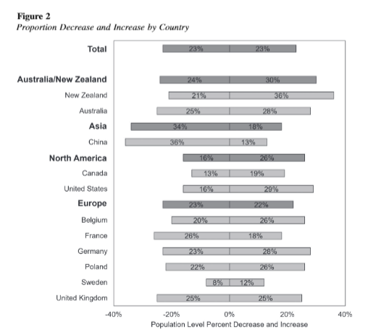
International Context
Review of 128 studies in 58 countries showed no overall population change in consumption in first 6-8 months of pandemic
Meta analysis did show percentage changes in consumption with 23% drinking more and 23% drinking less overall
Source: Acuff, S. F., Strickland, J. C., Tucker, J. A., & Murphy, J. G. (2022). Changes in alcohol use during COVID-19 and associations with contextual and individual difference variables: A systematic review and meta-analysis. Psychology of Addictive Behaviors, 36(1), 1–19. https://doi.org/10.1037/adb0000796

Slide 10
Increases were more likely amongst heavier drinkers
Systematic review of 56 population level surveys in 15 European countries
In general population found a small decrease in consumption
Evidence of increasing alcohol use among those already drinking at high levels or who reported Alcohol Use Disorder prior to COVID-19
Source: Kilian C, O'Donnell A, Potapova N, López-Pelayo H, Schulte B, Miquel L, Paniello Castillo B, Schmidt CS, Gual A, Rehm J, Manthey J. Changes in alcohol use during the COVID-19 pandemic in Europe: A meta-analysis of observational studies. Drug Alcohol Rev. 2022 May;41(4):918-931. doi: 10.1111/dar.13446.

Slide 11
Changes in Drinking Contexts
Reductions in on-trade alcohol consumption following COVID-19 lockdown restrictions in Scotland/England in 2020 were mainly offset by increased own-home drinking (Hardie et al., 2022)
Home alcohol expenditure increased during first lockdown (PHE 2021)

Slide 12

Changes in drinking contexts..
Lockdown restrictions were also associated with;
Later drinking start times
Fewer occasions in someone else’s home and with friends/colleagues
More own-home drinking
More solitary drinking (in Scotland only)
Source: I Hardie, AK Stevely, A Sasso, PS Meier & J Holmes (2022) The impact of changes in COVID-19 lockdown restrictions on alcohol consumption and drinking occasion characteristics in Scotland and England in 2020: an interrupted time-series analysis. Addiction https://doi.org/10.1111/add.15794

Slide 13

Why might these changes happen?
Psychological distress or stress
Availability or Affordability
Notes:
both as a consequence of measures taken to con-tain the spread of the virus, such as social isolation,income insecurity and job loss [6,11–13], as well asthe threat of personal exposure to COVID-19 or theillness of a loved one. Psychological pressure and dis-tress are known risk factors for high levels of alcoholintake [14,15] and therefore expected to lead toincreased consumption during the COVID-19 pan-demic. In contrast, the second mechanism suggests adecline in alcohol use due to the reduced availabilityand affordability of alcoholic beverages during thisperiod, as well as a reduction in potential drinkingoccasions due to measures aimed at limiting socialgatherings [1,6]. Evidence for this mechanism emergesfrom alcohol policy research, highlighting reducedavailability and affordability of alcoholic beverages aseffective policy measures to reduce alcohol use at thepopulation level [16] (both policies are part of theWHO’s‘Best Buys’to reduce alcohol use, see [17]).Both of these mechanisms may have played an impor-tant role in stimulating

Slide 14
Changes in consumption were not momentary/short lived…

Slide 15
After 6 months, changes in drinking were maintained..
 | All n=1838 | Female n=1302 | Male n=525
Drinking more at 6 month FU | 28% | 25% | 36%
Drinking same at 6 month FU | 40% | 42% | 35%
Drinking Less at 6 month FU | 32% | 33% | 29%
Source: Oldham, M., Garnett, C., Brown, J., Kale, D., Shahab, L. and Herbec, A. (in press). Factors associated with longitudinal changes in alcohol consumption between the first lockdown and six-month follow-up during the COVID-19 pandemic in the UK.

Slide 16
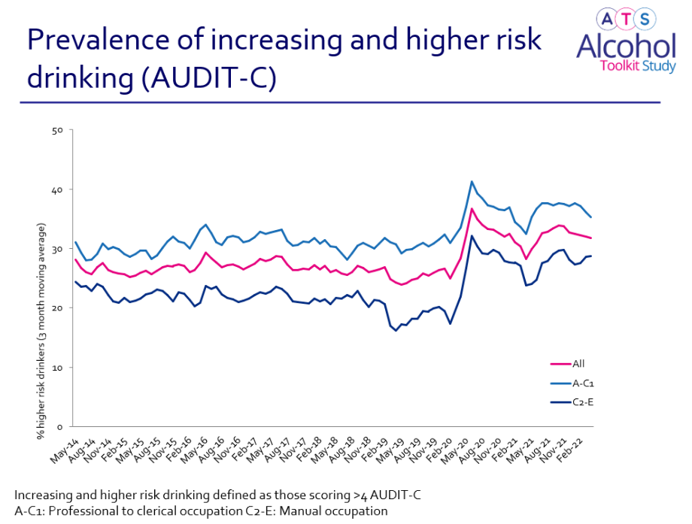
Prevalence of high-risk drinking is higher than pre-pandemic levels..

Slide 17
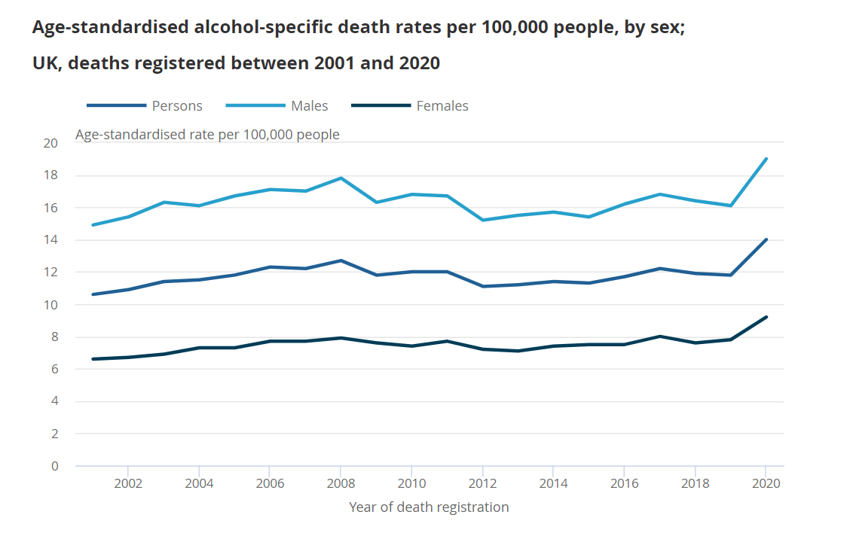
Alcohol mortality ONS report
In 2020 there was an 18.6% increase in deaths from alcohol-specific causes registered in the UK compared with 2019
Rate of alcohol-specific deaths for males in 2020 remained more than double the rate for females

Slide 18
However, maybe some good(ish) news…

Slide 19
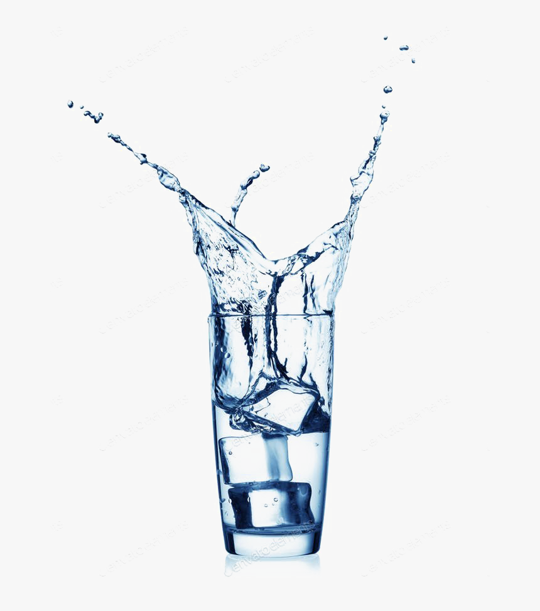
Reduction Attempts amongst high-risk drinkers
As well as leading to increased consumption, the first lockdown also led to an increase in self-reported alcohol reduction attempts by high-risk drinkers
28.5% during lockdown vs. 15.3% pre-lockdown
Source: Jackson, S. E., Garnett, C., Shahab, L., Oldham, M., and Brown, J. (2021) Association of the COVID‐19 lockdown with smoking, drinking and attempts to quit in England: an analysis of 2019–20 data. Addiction, 116: 1233– 1244.

Slide 20
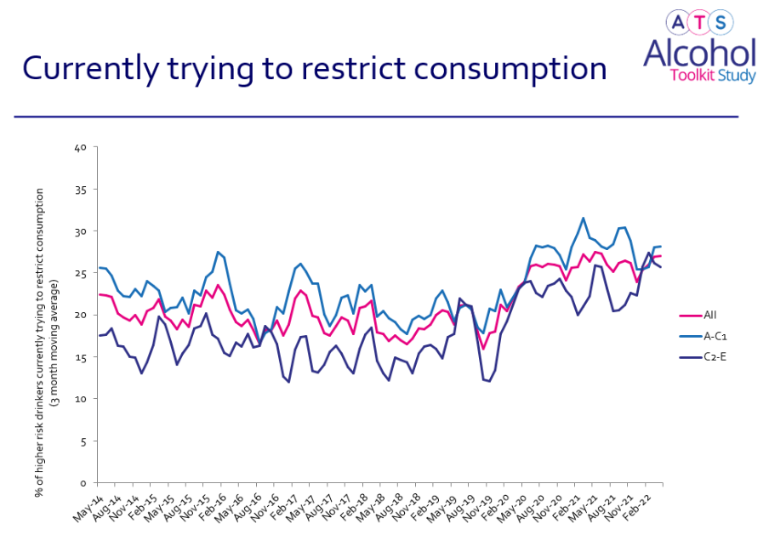
Proportion trying to restrict stayed higher than pre pandemic

Slide 21
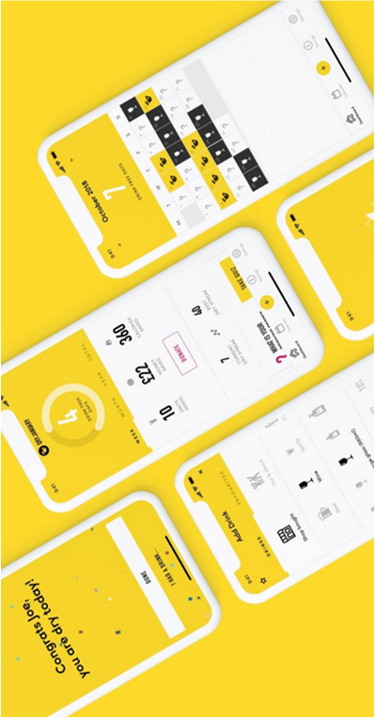
Dry January Engagement 2020 vs 2021
Significant increase in the proportion of increasing and higher risk drinkers reporting dry January attempts from 4% in 2020 to 8% in 2021
There was also an increase in Dry January app use from 43, 868 in January 2020 to 60, 730 in 2021
Groups looked comparable in terms of socio-demographics

Slide 22
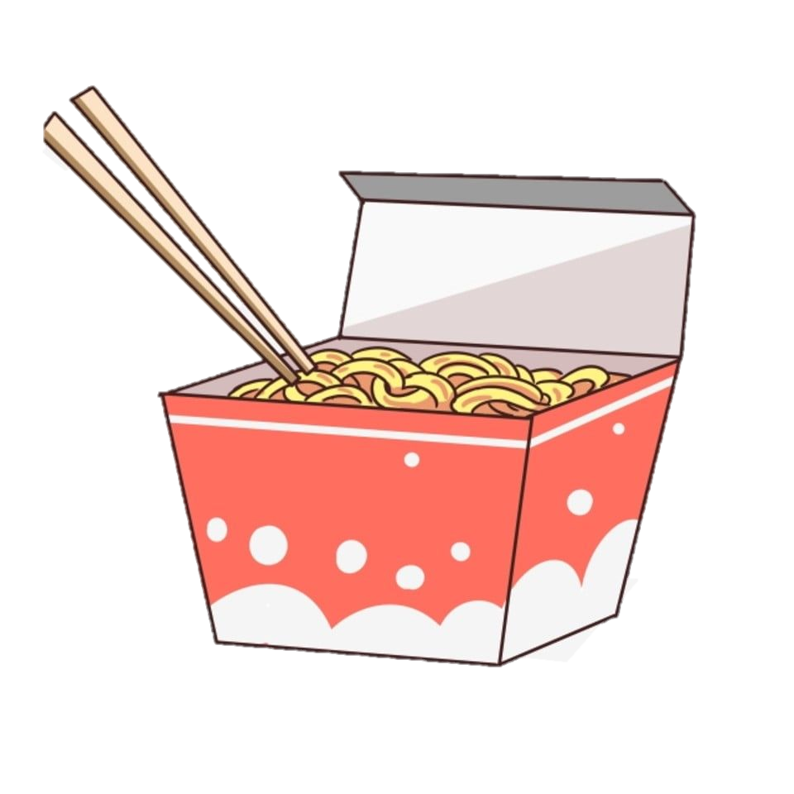
Take Home Messages
Overall - no population level change
Polarising trends in consumption in shorter and longer term
Increased consumption may be more likely among heavier drinkers
This will have knock on effects for Public Health
Possibly maybe a silver lining – more interest in reducing consumption amongst heavier drinkers
How do we capitalise on this?

Slide 23
