Slide 1



Department of Epidemiology and Public Health
Partners, friends, and family: the good, the bad, and the ugly of social support and alcohol consumption
Philippa Case
Supervisors: Prof Annie Britton,
Dr Paola Zaninotto, Dr Fiona Aspinal

Slide 2
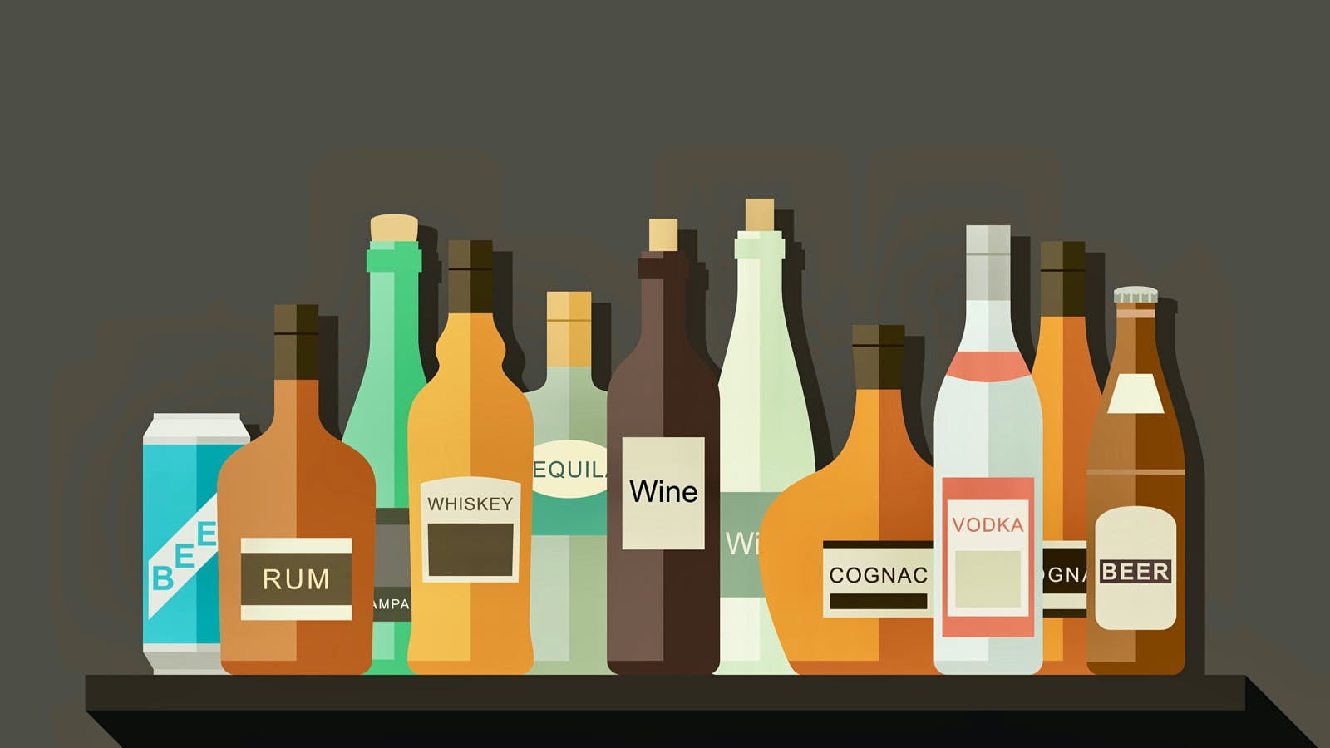


Drinking in England
83% drank in last year
30% above
low risk
77% drank in last year
15%
above
low risk
Notes:
One unit equals 10ml or 8g of pure alcohol, which is around the amount of alcohol the average adult can process in an hour.
14 units = 140ml or 112g pure alcohol
39% and 20% in 55-64 year olds

Slide 3
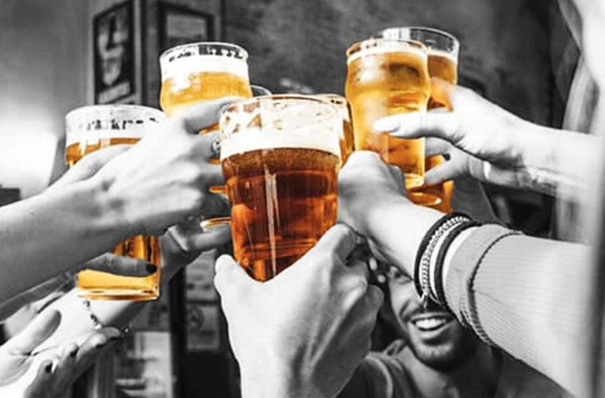
Social motives for drinking
“Routine part of the social landscape”
Facilitator
Integral part of socialising
Social norms and belonging
Enabling emotional sharing

Slide 4
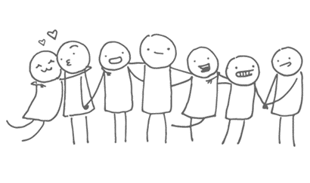
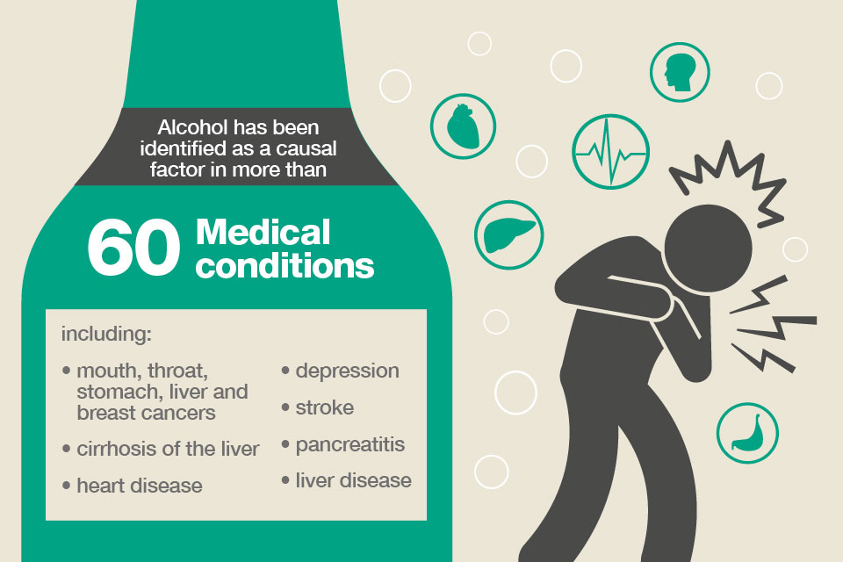
Social support, health and alcohol
Positive social support
(e.g. supportive relationships)
Positive health behaviours
(e.g. exercise, quitting smoking)
Positive health outcomes
(e.g. reduced risk of morbidity and mortality)
Positive social support
(e.g. spending time with friends)
Alcohol consumption
Potential negative health outcomes
Notes:
Unpicking this relationship is important:
Because the lack of effectiveness we see around alcohol messaging such as drinking guidelines might be explained by the fact that these sometimes abstract future health messages are in conflict with our normal social practices, and
Because if we want to address population alcohol consumption, we want to do so whilst maintaiing any social benefit that are gained from drinking

Slide 5
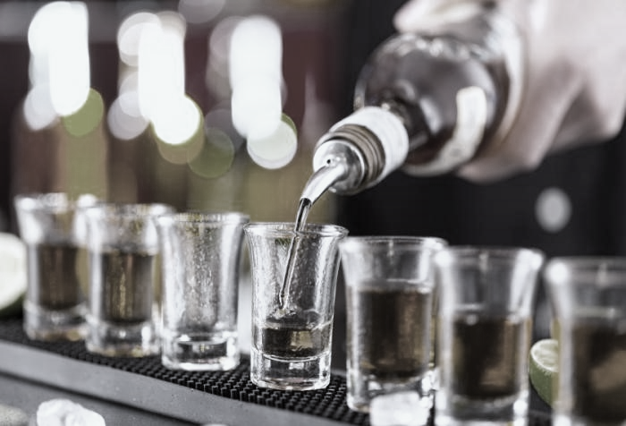
Aim
To explore the interplay between social support and alcohol consumption at different stages of the life course

Slide 6

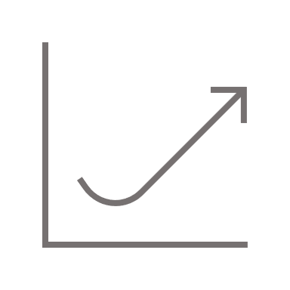

Methodology: Mixed methods
Quantitative study 1
Quantitative study 2
Qualitative study
Notes:
Aged 63

Slide 7
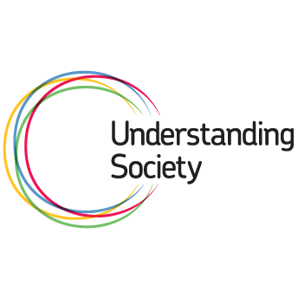

Methods
Quantitative study 1
Mid-adults: N=6,028-7,840
Logistic regression analyses
Quantitative study 2
Mid-adults: N=9,037-11,603
Confirmatory factor analysis
Mediation analysis using structural equation modelling
Qualitative study
12 adults accessing alcohol treatment services (age 32-56)
Thematic analysis
Notes:
Participants: early adults (N= 2,855-12,122)
Mid-adults (N=6028-7840)
Participants: Early adults (N=1284-4568)
Mid-adults (N=9037-11,603)

Slide 8

Results: Study 1
Closest person
Partner Parent/sibling Friend
Partner Parent/sibling Friend

Slide 9
Results: Study 1
Emotional/confiding support
Middle tertile Highest tertile
Middle tertile Highest tertile

Slide 10
Results: Study 1
Negative support
Middle tertile Highest tertile
Middle tertile Highest tertile
Notes:
Amongst married and cohabiting men in mid-adulthood, those receiving the highest level of emotional/confiding support (vs lowest level) were significantly less likely significantly less likely to be higher risk drinkers (RRR=0.44, 95%CI=0.27-0.74). Amongst unmarried men, the relationship between the highest level of confiding/emotional support was non-significant and in the opposite direction (RRR=1.96, 95%CI=0.83-4.63).
Amongst unmarried women in mid-adulthood, those receiving the highest levels of confiding/emotional support were significantly more likely to be increased risk drinkers (RRR=2.00, 95%CI=1.08-3.69), whereas no such relationship was present amongst married women (RRR=0.98, 0.75-1.27).

Slide 11

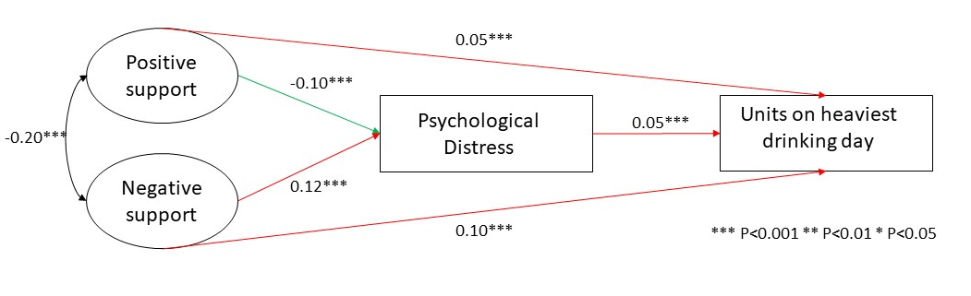
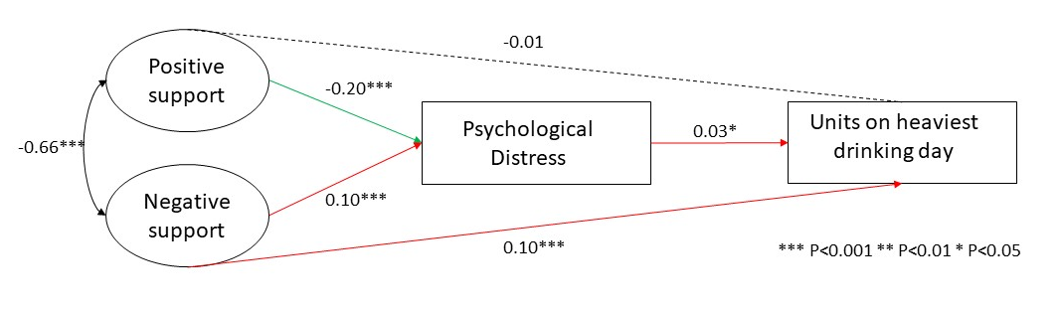
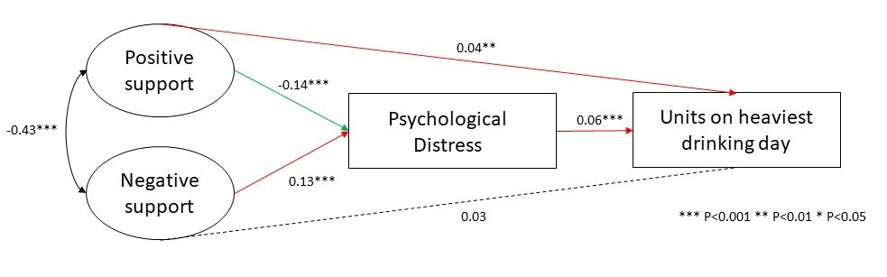
Results: Study 2
Positive support
Positive support from friends and relatives was directly linked to higher units consumed.
However, positive support from partner was not directly linked to units consumed.
Positive support from friends, partner and relatives was linked to lower psychological distress, and greater psychological distress was linked to higher units consumed. These indirect effects were statistically significant (friends: IND=-.005, p<.001, partner: IND=-.006, p=.01, relatives: IND=-0.01, p<.001).
Support from friends
Support from partner
Support from relatives

Slide 12
Results: Study 2
Negative support
Negative support from both friends and partner was directly linked to higher units consumed on heaviest drinking day in previous week.
However, negative support from relatives was not directly linked to units consumed.
Negative support from friends, partner and relatives was linked to greater psychological distress, which was linked to higher units consumed and these indirect effects were statistically significant (friends: IND=.006, p<.001, partner: IND=.003, p=.02, IND=0.01, p<.001).
Support from friends
Support from partner
Support from relatives

Slide 13

Results: Study 3
Reasons for drinking
I was drinking just to numb it, just to numb shit. Cos I didn’t want to think about it anymore. (Participant F, female)
I drink more when I get angry. Like, if I start rowing with my son or my partner, the first thing I think is “I need a drink, I need a drink”. (Participant E, female)
Drinking to manage negative emotions
Drinking as a consequence of social conflict

Slide 14
Results: Study 3
Drinking pathways to social isolation
And then I lost the job, which I fought really hard to get, and I lost it anyway, and then I lost my relationship, and I lost the kids. […] and then I went out and went crazy. (Participant H, male)
And I was still hiding it, and lying to my husband and saying, “No, I haven’t been drinking” and that would obviously cause a massive rift between us, cos he knew I was, and I’m saying I wasn’t. (Participant F, fem.)
Conflict and social losses
Disconnection from others

Slide 15
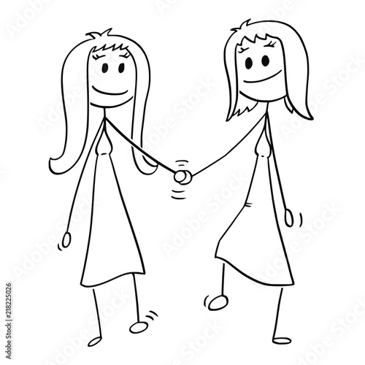
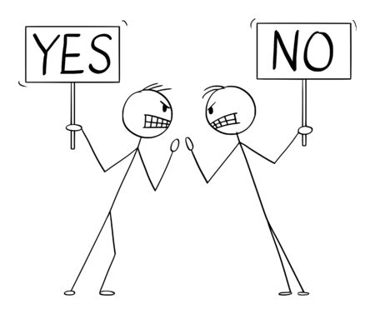
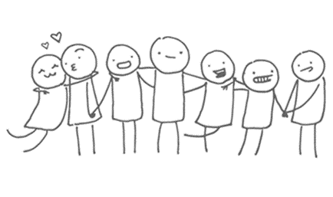
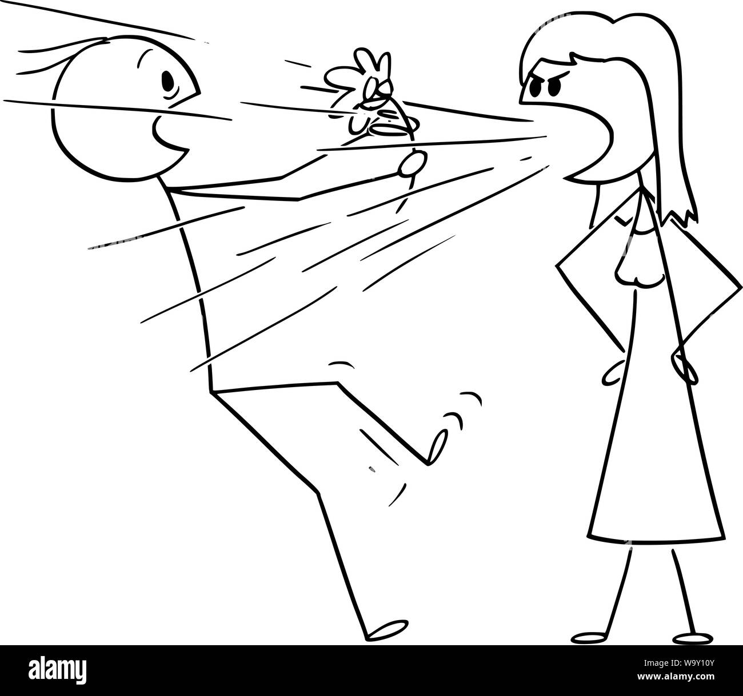
Overall findings
Key areas of social support associated with risky alcohol consumption:
Conflict and negative support
Friendships
Partners?
Psychological distress

Slide 16
Key practice and policy recommendations
Assessing drinking motives in alcohol brief interventions
Maintaining friendships whilst reducing alcohol consumption: peer campaigns, stigma, non-drinking options
Early intervention in alcohol treatment and working with families and friends

Slide 17

With thanks to
Prof Annie Britton,
Dr Paola Zaninotto,
Dr Fiona Aspinal
MRC DTP
Participants and staff

Slide 18


Thank you for listening
p.case-442@kent.ac.uk
@PhilippaCase

Slide 19
References
World Health Organization. Global status report on alcohol and health 2018 [Internet]. 2018 [cited 2018 Dec 4]. Available from: http://www.who.int/substance_abuse/publications/global_alcohol_report/gsr_2018/en/
Bankiewicz U, Robinson C, Neave A. Health survey for England 2019: Adults’ health-related behaviours [Internet]. 2020. Available from: https://files.digital.nhs.uk/D4/93337C/HSE19-Adult-health-behaviours-rep.pdf
Kelly S, Olanrewaju O, Cowan A, Brayne C, Lafortune L. Alcohol and older people: A systematic review of barriers, facilitators and context of drinking in older people and implications for intervention design. PLoS One [Internet]. 2018;13(1). Available from: https://doi.org/10.1371/journal.pone.0191189
Emslie C, Hunt K, Lyons A. Older and wiser? Men’s and women’s accounts of drinking in early mid-life. Sociol Heal Illn. 2012;34(4):481–96.
Mikkelsen SS, Tolstrup JS, Becker U, Mortensen EL, Flensborg-Madsen T. Social network as predictor for onset of alcohol use disorder: A prospective cohort study. Compr Psychiatry [Internet]. 2015;61:57–63. Available from: http://dx.doi.org/10.1016/j.comppsych.2015.05.005
Watt RG, Heilmann A, Sabbah W, Newton T, Chandola T, Aida J, et al. Social relationships and health related behaviors among older US adults. BMC Public Health. 2014;14(1):1–11.
Green C a, Freeborn DK, Polen MR. Gender and alcohol use: the roles of social support, chronic illness, and psychological well-being. J Behav Med. 2001;24(4):383–99.
Kobayashi LC, Steptoe A. Social Isolation, Loneliness, and Health Behaviors at Older Ages: Longitudinal Cohort Study. Ann Behav Med [Internet]. 2018;582–93. Available from: https://academic.oup.com/abm/advance-article/doi/10.1093/abm/kax033/4825275
Ng Fat L, Scholes S, Jivraj S. The Relationship Between Drinking Pattern, Social Capital, and Area-Deprivation: Findings From the Health Survey for England. J Stud Alcohol Drugs [Internet]. 2017;78(1):20–9. Available from: http://www.jsad.com/doi/10.15288/jsad.2017.78.20
Stickley A, Koyanagi A, Koposov R, Schwab-Stone M, Ruchkin V. Loneliness and health risk behaviours among Russian and U.S. adolescents: A cross-sectional study. BMC Public Health. 2014;14(1).
Hajek A, Bock JO, Weyerer S, König HH. Correlates of alcohol consumption among Germans in the second half of life. Results of a population-based observational study. BMC Geriatr. 2017;17(1):1–13.
Iparraguirre J. Socioeconomic determinants of risk of harmful alcohol drinking among people aged 50 or over in England. BMJ Open. 2015;5(7).
Canham SL, Mauro PM, Kaufmann CN, Sixsmith A. Association of Alcohol Use and Loneliness Frequency among Middle-Aged and Older Adult Drinkers. J Aging Health. 2016;28(2):267–84.
Sacco P, Bucholz KK, Harrington D. Gender Differences in Stressful Life Events, Social Support, Perceived Stress, and Alcohol Use Among Older Adults: Results From a National Survey. Subst Use Misuse [Internet]. 2014;49(4):456–65. Available from: http://www.tandfonline.com/doi/full/10.3109/10826084.2013.846379
Croezen S, Picavet HSJ, Haveman-Nies A, Verschuren WM, De Groot LC, Van’T Veer P. Do positive or negative experiences of social support relate to current and future health? Results from the Doetinchem Cohort Study. BMC Public Health [Internet]. 2012;12(1):65. Available from: http://www.biomedcentral.com/1471-2458/12/65

