Slide 1


A feasibility study of the Blue Light Project in Merseyside: working with the Police Service and Homeless services to reduce alcohol harms
Dr Patsy Irizar (University of Manchester)
Patricia.irizar@manchester.ac.uk
Notes:
I’m Patsy Irizar, I’m currently working as a research associate at the University of Manchester, researching ethnic inequalities in COVID-19 health outcomes.
I recently completed my PhD at the University of Liverpool, where I investigated the level of alcohol use and co-occurring mental health problems in the UK Police Service.
I am now also a Co-Investigator on a small six month project that I am going to talk about today. The project is a feasibility study of the Blue Light Project in Mersey side, which involves training police officers and staff from homeless services to better support people with alcohol problems.

Slide 2



Acknowledgements
This research is funded by the Liverpool Clinical Commissioning Group (LCCG): Research Capability Funding 2021/2022
Thank you to Champs who have provided additional funding
Principal Investigator: Dr Laura Goodwin (Lancaster University)
Co-Investigators: Dr Carly Lightowlers (University of Liverpool), Prof Sir Ian Gilmore (University of Liverpool), Dr Louise Roper (University of Liverpool, Housing First), Prof Zara Quigg (Liverpool John Moores University), Prof Dorothy Newbury-Birch (Teeside University), Prof Simon Coulton (University of Kent), Mike Ward (Alcohol Change UK), Raj Kapoor (Alcohol Change UK)
Patient & Public Involvement (PPI) Co-Investigator: Terry Leighton (Change Grow Live)
Notes:
I’d first like to thank the principal investigator, Dr Laura Goodwin, our co-investigators, and our PPI lead.
This project is funded by the Liverpool Clinical Commissioning Group and Champs Public Health Collaborative.

Slide 3
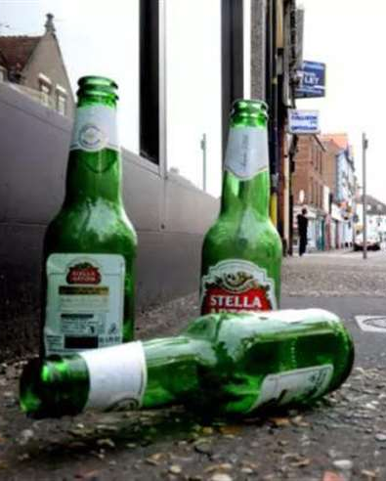
The burden of alcohol
Globally, 6% of all deaths and 5% of all disease and injury are attributable to alcohol (WHO, 2019)
In the UK, 20% of patients in hospital use alcohol harmfully and 10% are alcohol dependent (Roberts et al., 2019)
The costs of alcohol to the NHS are estimated to be £3.5 billion per year (Williams et al., 2020)
Alcohol-related crimes estimated to cost £11 billion per year (Home Office, 2013)
The overall costs to the economy estimated at £21 billion a year (Williams et al., 2020)
Notes:
Alcohol contributes significantly to physical and social harms.
Across the world, 6% of all deaths and 5% of all diseases are attributable to alcohol.
Alcohol impacts hospital admissions, as alcohol-related frequent attenders account for a high proportion of unplanned hospital admissions.
In the UK, it is estimated that 1 in 5 patients who are in hospital use alcohol harmfully and 1 in 10 patients in hospital are alcohol dependent.
The costs of alcohol to the NHS are estimated to be £3.5 billion per year, and the wider costs of alcohol to the economy are estimated to be £21 billion per year, which includes £11 billion per year for alcohol-related crimes.

Slide 4
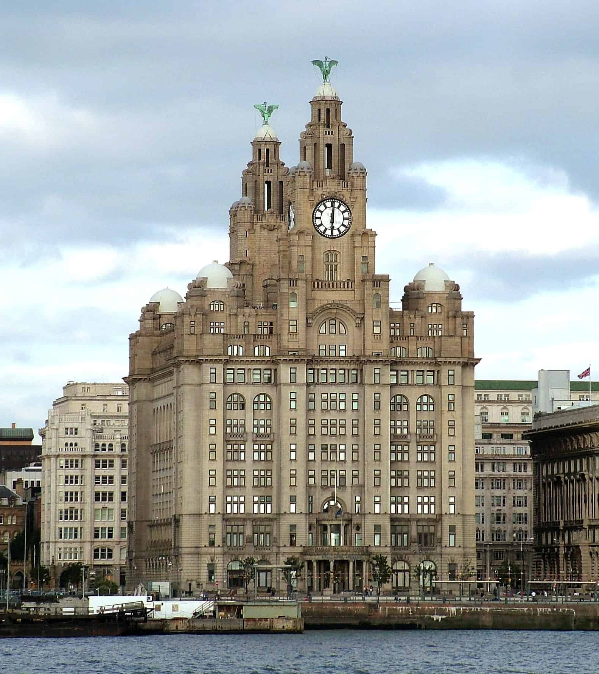
The burden of alcohol in Merseyside
Alcohol consumption contributes significantly to health inequalities (Bellis et al., 2016)
Merseyside is one of the 20% most deprived districts in England (Public Health England, 2019)
  Reduced life expectancy
  High rate of alcohol-related hospital admissions
Approximately 4,500 alcohol-related hospital admissions in Liverpool each year (PHE, 2019)
Liverpool Echo: 9,555 adults met criteria for alcohol dependency in 2018
  The same year, Liverpool City Council cut budgets for alcohol services by £2.1 million
Notes:
The relationship between alcohol consumption and harm is complicated by deprivation.
Research shows that lower socioeconomic status populations experience greater harms from alcohol, despite drinking to similar or lower levels.
This is what is known as the alcohol harms paradox.
Merseyside is one of the 20% most deprived regions in England, with significantly reduced life expectancy for both men and women.
The rate of alcohol-related hospital admissions is also much greater in Merseyside compared to the average for the UK.
It is estimated that there are 4,500 alcohol-related hospital admissions in Liverpool each year.
A story published in the Echo stated that 9,500 adults met criteria for alcohol dependency in Liverpool in 2018, which was the same year that Liverpool City Council cut budgets to alcohol services by £2.1 million.
Worryingly, only 20% of people who are alcohol dependent are in treatment (Blackwood et al., 2020)
Carol Black Review:
Urgent need for better support for people with alcohol problems
Years of funding cuts and a reduction in services (approximately £162 million)
The impacts of this are even greater in areas of higher deprivation, with established inequalities in alcohol-related harms in Merseyside

Slide 5

Alcohol-related hospital admissions in 2019
Notes:
This graph shows that the rate of alcohol-related hospital admissions in Liverpool is nearly 1000 per 100,000, compared to approximately 600 per 100,000 for the UK average

Slide 6
Populations at risk of alcohol-related harms
Alcohol problems often co-occur with mental health problems (Puddephatt et al., 2020)
  Both problems are highly prevalent in people experiencing multiple disadvantages (Beard et al., 2019; Puddephatt et al., 2020)
Individuals with multiple disadvantages (such as homeless populations) are frequent users of emergency services (Drummond et al., 2019)
The prevalence of alcohol problems are significantly higher in police custody settings (Newbury-Birch et al., 2016) and in homeless populations, compared to the general population (McManus et al., 2016)
Notes:
Certain populations are more at-risk of alcohol-related harms.
For example, people experiencing trauma or poor mental health often have co-occurring alcohol problems, as alcohol can be used to cope with negative feelings.
People with co-occurring problems may be more likely to experience alcohol-related harms.
Individuals experiencing multiple disadvantages, like homelessness, domestic violence, poor mental health, are also at risk of alcohol-related harms and are frequent users of emergency services, such as A&E admissions, police call-outs, and sometimes fire services.
This may be related to difficulties in accessing GP or other support services, due to not having a fixed address.
Evidence shows that the prevalence of alcohol problems are much higher in police custody settings and in homeless populations, compared to the general population.
Therefore, people experiencing multiple disadvantages are at high-risk of alcohol-related harms and are often not engaged in treatment services, meaning they are more likely to use emergency services.

Slide 7

Alcohol in a policing context
The police are often the first point of contact for alcohol-related injuries or crimes
Criminal justice settings can be suitable for delivery of brief alcohol interventions (Addison et al., 2018; Brown et al., 2010; Coulton et al., 2021)
Approximately half of police officers’ workload is alcohol-related (Institute of Alcohol Studies, 2015)
Consultations with Merseyside police have told us that they currently don’t have:
  Focused alcohol training
  Networks with relevant services (e.g., homeless and drug/alcohol services)
Notes:
As people with multiple disadvantages are often frequent users of emergency services, the police are often the first point of contact for alcohol-related injuries or crimes.
There is some evidence to suggest that criminal justice settings, particularly police custody, are suitable for the delivery of brief alcohol interventions.
However, there is limited evidence as to whether they are effective in reducing alcohol-related harms.
Reducing the number of alcohol-related police call outs would be beneficial to the police and those needing alcohol support, as approximately half of police officers’ workload is alcohol-related.
However, they currently do not have the tools or knowledge to support people with alcohol problems.
Consultations with Merseyside police have told us that they currently do not have any focussed alcohol training or the necessary networks with relevant services (such as homeless services and drug or alcohol services).
Though the Government has recently set up Project ADDER, which is aiming to reduce substance-related crimes through increased funding to addiction services and closer working with the Police Service.

Slide 8
The Blue Light Project (Alcohol Change UK)
The Blue Light project was developed by Alcohol Change UK
An approach for working with dependent drinkers who are not engaged with alcohol treatment services
These individuals are likely to be frequent users of services including healthcare, housing and the criminal justice system
The project provides training to staff in services to help them to better support an individual to reduce the physical and social harms of their drinking, even before they may be ready to start formal treatment
Examples: In Sandwell, after one year of Blue Light, the overall costs associated with 16 high-impact individuals reduced from £250,000 to £90,000. Large cost savings were also observed in Nottingham, with a reduction of £360,000 in healthcare costs after one year.
Notes:
Alcohol Change UK have created an initiative to support people with alcohol problems who are not engaged in treatment services, titled the Blue Light Project.
These individuals often experience multiple disadvantages and are frequent users of emergency services, such as the police.
The Blue Light project encourages multi-agency working within a region, focussing on reducing the physical and social harms for a small number of ‘Blue Light Clients’, who tend to have a high-impact in relation to costs to emergency services.
The initiative provides training to staff in services to help them to better support an individual to reduce the physical and social harms of their drinking, even before they may be ready to start formal treatment.
The Blue Light Project has been delivered in Sandwell and Nottingham, and this has resulted in large cost savings. For example, in Sandwell, the overall costs associated with 16 individuals reduced from a quarter of a million a year to £90,000.

Slide 9
Aims of this feasibility study
To work with police officers, staff from homeless services, and people with lived experience to tailor the existing Blue Light training for this context
To assess the feasibility of rolling out the Blue Light training to police officers and representatives from homeless services across Liverpool
To examine the implementation and mechanisms of impact of the Blue Light training (e.g., changes in attitudes and perceptions of alcohol-related stigma)
Notes:
We wanted to tailor the existing Blue Light Project for a Merseyside context, specifically for police officers and staff from homeless organisations. We aim:
To use co-production techniques, working with police officers, staff from homeless services, and people with lived experience of alcohol problems to tailor the existing Blue Light training for this context
To assess the feasibility of rolling of the Blue Light training to police officers and representatives from homeless services across Liverpool to assess uptake of the training and acceptability of the programme
To examine the implementation and mechanisms of impact of the Blue Light training (e.g., changes in attitudes and perceptions of alcohol-related stigma)

Slide 10
Overview of the project
Work Package 1: Using co-production techniques to tailor the Blue Light training programme
1
Work Package 2: Delivery of training to police officers and staff from homeless services
2
Work Package 3: Interviews to assess the feasibility and acceptability training
3
Work Package 4: Qualitative evaluation to understand changes in practice and attitudes
4

Slide 11
Work Package 1
Co-production to tailor the Blue Light training programme
Completed!

Slide 12
Using co-production techniques to tailor the Blue Light training programme
Transdisciplinary Action Research (TDAR) (Hawkins et al., 2017)
A framework for co-production and prototyping
Supports collaboration between academic researchers and relevant stakeholder groups (e.g., public sector workers, policy makers and clinicians and people with lived experience of specific health problems)
Three stages:
  Stage 1 – stakeholder consultation
  Stage 2 – co-production
  Stage 3 – prototyping
Notes:
The first work package followed the Transdisciplinary Action Research framework for co-production and proto-typing.
This framework supports collaboration between academic researchers and relevant stakeholder groups, through three stages:
The first stage involves stakeholder consultation, the second is co-production, and the third is prototyping.
I’m going to talk through what we did for each stage.

Slide 13
Stage 1: Stakeholder Consultation
Initial unstructured one-to-one consultations (some prior to project commencing)
Focus groups (approximately 5 members per group)
Objectives of consultations
Understanding of experiences working with people with alcohol problems
Rank Blue Light modules in order of importance or relevance to their work
Gather feedback on plans for additional modules
Suggestions for other additional modules
Notes:
Unstructured informal consultations took place before the project started/was awarded.
Laura conducted these (clinical commissioning group, CHAMPS, local authorities, NHS organisations) → informed how we set things up.
The one-to-one consultations related more to understanding the current context and any ongoing or new related initiatives e.g. Project Adder or any existing multi-disciplinary teams (there are some for complex needs, but not clear how police are represented at those).
Once we were awarded the funding, we held 3 focus groups on 28th March, each with about 5 members.
The aim of the focus groups was to understand the experiences of police officers and staff from homeless services working with people with alcohol problems.
Any situations where they were unsure what to do or how to support someone.
Gathered feedback on the existing Blue Light modules to see which aspects are most relevant to their experiences and which are least.
We had created some plans for additional modules and we wanted their feedback on them, as well as any suggestions for other additional modules or anything else people would find helpful.

Slide 14
Original Blue Light Modules
Introductory modules
Aims of Blue Light training
Working with Blue Light clients
Barriers to change
What works?
Overview of different interventions and treatment approaches (e.g., motivational interviewing)
Screening and personalised feedback
Engagement and referrals
Risk assessment and harm reduction
Dual diagnosis
Legal powers
Notes:
Legal powers least helpful to police officers as already aware so we removed them and circulated them as an extra document.

Slide 15
Stage 2: Co-production
Focussed workshops:
Working with representatives from the police and homeless services, relevant stakeholders from stage 1 and with people with lived experience of alcohol problems
These activities focussed on tailoring the training package
Findings from stage 1 were presented and discussed
People with lived experience shared their stories to produce training videos
Plans were refined until agreement was made as to how the intervention should be changed
Notes:
Based on the consultations, we held 3 more focussed workshops with really specific questions, to find out exactly what people needed from the training and what they already knew.
For example, there was a big focus on alcohol screening and feedback, awareness of different alcohol services in Liverpool, understanding of the relationship between alcohol and mental health, and any existing training surrounding mental health.
We also did several interviews with people with lived experience of alcohol problems and created videos to share their experiences. I will talk about these videos in a bit more detail later.

Slide 16
Stage 3: Prototyping
Updated training materials:
Reduced content for modules that were rated as the least useful or relevant
Additional modules or content where needed
Referral pack
Videos sharing stories of lived experience
The updated training materials were reviewed by members of the research team
Notes:
For the third stage, we share prototypes of the updated training materials.
This included reduced content for modules that were rated as the least useful, for example ‘legal powers’ module removed and shared in a document instead. Additional modules, a referral pack, and videos of lived experience. I will talk about each of these in more detail now.
We ran out of time for this stage as it is only a 6-month project and we have no researcher…
We would have liked to have had all materials reviewed by PPI leads and by representatives from the police and homeless services, but it was mainly reviewed by the research team.
After the first full day training, we got some feedback on the training and modules, to make any changes and to inform the half day training.

Slide 17
Additional Content
Harm-reduction approaches
Co-occurring alcohol and mental health problems
Screening and assessment (brief alcohol interventions)
Language around alcohol use and stigma
Notes:
We added more content on what we mean by harm reduction and issues around when someone may be experiencing alcohol withdrawal and what the medical risks of this can be.
We added a module on co-occurring alcohol and mental health problems to show that this will be more common than people expect. We added some specific advice in this section about why mental health is important to consider for anyone drinking at a dependent level
to “humanise and contextualise” drinking to excess as a coping mechanism, to bring empathy and understanding to people’s situations.
We made the morning session of the Blue Light Project to be focussed on screening and assessment as we want to give people advice about asking about drinking in all groups – not just those with obvious alcohol dependence.
Finally, we added a module on language around alcohol use and stigma. We gave an overview of the kinds of terminology that we should use, what terms might be unhelpful to people and why.

Slide 18
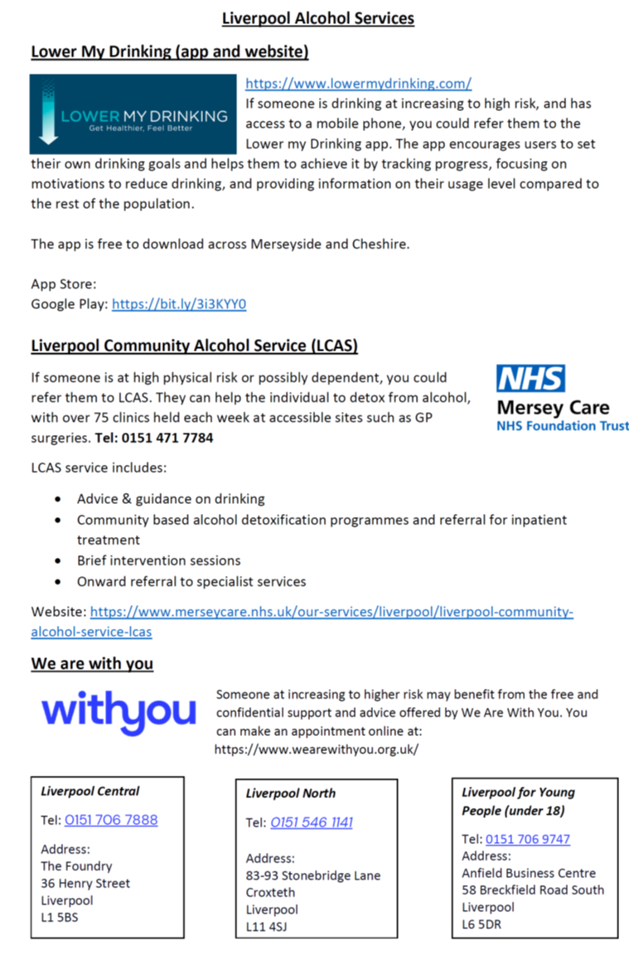
Referral pack
Focussing on how to ask about alcohol use and harms
  E.g., AUDIT-C
  12 questions on physical harms
Contact details for alcohol and homeless services in Merseyside
Notes:
Our workshops identified that people were not aware of the relevant services in Merseyside, such as drug and alcohol services, or housing support services.
We created a referral document that we shared with everyone who attended the training. This included a list of relevant services, but also some information about how to ask someone about their drinking, including the AUDIT-C and 12 questions to determine physical harms that may be caused by drinking.

Slide 19
Videos:
1. Experiences of drinking and motivations
2. Experiences with police/homeless services
3. Language around alcohol use
Notes:
We interviewed people with lived experience of alcohol problems, and with their permission, we got actors to narrate their stories to create videos.
We created 3 videos in total. The first was about their experiences of drinking and the reasons why they drank alcohol. The second was about their experiences with police and homeless services, which included some negative and some positive experiences, and what went well or what could have been handled better. The final video was about the language they would prefer people to use when talking about their drinking and any language they find stigmatising.

Slide 20
Work Package 2
Delivering the training
On-going!

Slide 21
Delivery of Blue Light training
Who will receive training?
  Key representatives from the police (e.g., response, neighbourhood policing teams and including PCSOs) and homeless services
What training will they receive?
  The full Blue Light 1-day training package has been provided (N~50)
  A reduced version of the training (0.5 days) will be delivered to police officers and staff from homeless services on a larger scale (N~150)
  Delivered in local police stations
Plans for train-the-trainer sessions to ensure sustainability
Notes:
Currently done 3 full-day training sessions
Delivered to police officers from a range of relevant roles and staff working in homeless services.
Approximately 50 people will receive the full-day training and a further 150 people are going to receive a reduced version of the training.
The tailored training is being delivered in local police stations by Mike Ward who usually delivers the Blue Light training.
Train the trainer is only for full day people

Slide 22
Work Packages 3 & 4
Interviews & evaluation
Upcoming!

Slide 23

Evaluation of the feasibility and acceptability
Assessment of feasibility and acceptability will include:
  Interviews with police officers and staff from homeless services who received the training and senior representatives who implemented the training programmes (n~20)
  Reviewing numbers for attendance at training sessions and number of drop-outs, including reviewing whether take-up differs across services
  Working with the police to review data on individuals with frequent call outs to determine if there have been any changes

Slide 24
Assessing the following outcomes
Acceptability
Demand
Implementation and integration
Practicality
Adaptation
Expansion
Limited-efficacy testing
Notes:
Acceptability: practical aspects of the training, the venue and the timing and how it fitted around their role demands and other responsibilities (e.g. childcare).
Demand: uptake of training, acceptance rate is for booking the training, how many people attend and what the dropout rate is.
Implementation and Integration: any logistical issues with delivery of the training and how the training can be integrated into the existing protocols
Practicality: how the training fits with the schedules, whether the roll-out schedule is feasible, and if the duration of the training is perceived to be suitable.
Adaptation: any further adaptations need to be made.
Expansion: consultations around delivering train-the-trainer sessions and working with directors of public health to understand how similar approaches can be delivered in other regions
Limited-efficacy testing: review the numbers of people categorised as being in receipt of frequent call outs to determine any change over time and consultations with senior police staff will review if there have been any broader impacts on practice.

Slide 25
Evaluation of the feasibility and acceptability
Qualitative analyses of the interview data will use framework analysis
  Builds on thematic analysis to develop and framework to inform changes in practice
Normalisation Process Theory (NPT):
  Coherence – does the intervention make sense?
  Cognitive participation – are people committed to delivering the intervention?
  Collective action – what resources are needed to deliver the intervention?
  Reflexive monitoring – are people convinced by the benefits of the intervention? Can it be integrated into everyday practice? Have attitudes about alcohol problems changed?

Slide 26

What next?
Expected outcomes and future plans

Slide 27
What difference will this project make?
Short-term Impacts
Capacity building around preventing alcohol harms in the police and homeless services
Changes in practice within Merseyside police in working with clients with alcohol problems
Increasing the delivery of brief alcohol interventions in Merseyside
Increased support and better referrals
Long-term Impacts
Reduction in the health inequalities experienced by harmful drinkers in Liverpool, through better referrals and to alcohol treatment services
Development of sustainable approaches (e.g., train the trainer) to ensure that training is maintained
Building networks across community policing teams with general practices (e.g., with social prescribing leads)

Slide 28
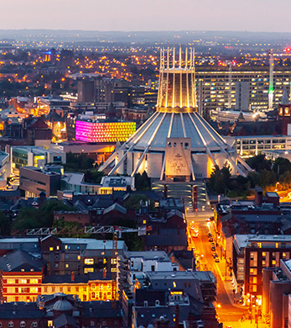
Evaluating the effectiveness of the Blue Light project
This feasibility study will lead into a larger scale public health intervention
Plans for a natural experiment evaluating the delivery of the Blue Light project and implementation of the multi-agency working
Possible outcomes: alcohol-related hospital admissions, alcohol-related crimes, economic evaluation

Slide 29
Thank you for listening!
Any questions?
Patricia.irizar@manchester.ac.uk

